Slide 1
Text Analytics
Università di Pisa
Giuseppe Attardi
Dipartimento di Informatica
Università di Pisa

Slide 2
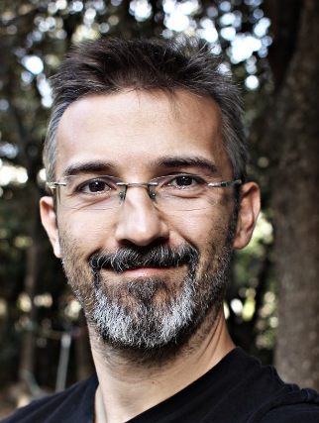
Instructors
Giuseppe Attardi
Office: 292
mail: attardi@di.unipi.it
web: www.di.unipi.it/~attardi
Andrea Esuli
ISTI - CNR
mail: andrea.esuli@isti.cnr.it
web: http://www.esuli.it/

Slide 3
Course Info
Course Page:
http://didawiki.di.unipi.it/doku.php/mds/txa/start
Hours:
Monday 11-13, Room X1
Tuesday 9-11, Room X1

Slide 4
Motivations
Facts
Definition
Text is everywhere:
books, web, news
Humans communicate with text:
email, social media
Over 80% of information is expressed as unstructured data:
40 million articles in Wikipedia
4.5 billion Web pages
about 500 million tweets a day
1.5 trillion queries in a year
Text analytics is the process of converting unstructured text data into meaningful data for analysis, to measure customer opinions, product reviews, feedback, to provide search facility, sentimental analysis and entity modeling to support fact based decision making.

Slide 5
Applications
Traditional
Advanced
analysis and classification of news reports
filtering emails and spam
extracting topics from web pages
Database population
Opinion mining
automating ontology extraction
management and collecting competitive intelligence
Question Answering
Digital Assistants
Chatbots

Slide 6
Natural Language Processing
Sometimes simple statistical analysis of text is sufficient
Deeper analytics requires NLP capabilities
Exploiting digital knowledge
Communicating with digital assistants
But often programmers are fazed by natural language
most people just avoid the problem and get into XML, or menus and drop boxes, or …
Are these solutions natural?
Early days of computers, we had humans to learn computer languages
Graphical User Interfaces, provided better for of interaction through visual form
How can we teach language to computers?
Or help them learn it as kids do?

Slide 7
Limitations of Desktop Metaphor

Slide 8
Personal Computing
Desktop Metaphor: highly successful in making computers popular
Benefits:
Point and click intuitive and universal
Limitations:
Point and click involves quite elementary actions
People are required to perform more and more clerical tasks
We have become: bank clerks, typographers, illustrators, librarians

Slide 9
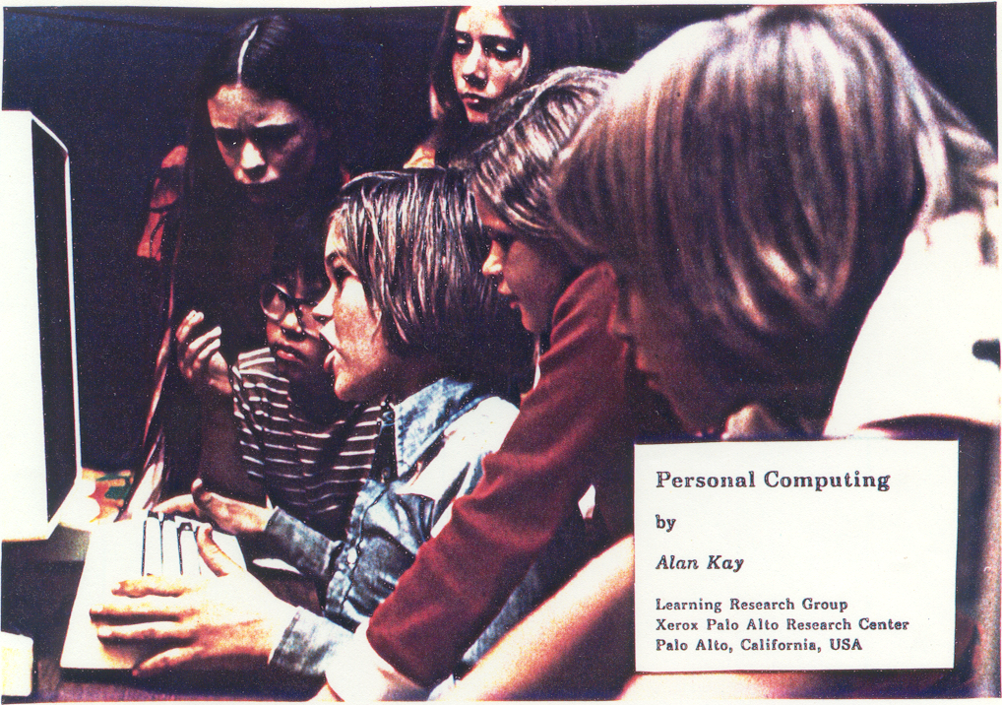

Slide 10
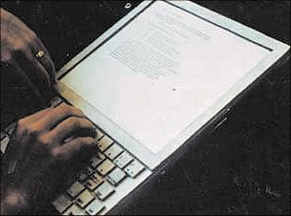
The DynaBook Concept (1973)

Slide 11
Kay’s Personal Computer
A quintessential device for expression and communication
Had to be portable and networked
For learning through experimentation, exploration and sharing

Slide 12
An Ordinary Task
Add a table to a document with results from latest benchmarks and send it to my colleague Antonio
7-8 point&click just to get to the document
dozen point&click to get to the data
lengthy fiddling with table layout
3-4 point&click to retrieve mail address
etc.

Slide 13
Prerequisites
Declarative vs Procedural Specification
Details irrelevant
Many possible answers: user will choose best

Slide 14
Going beyond Desktop Metaphor
Just one way:
Raise the level of interaction with computers
How?
Use natural language

Slide 15
NLP: Science Fiction
Star Trek
universal translator: Babel Fish
Language Interaction

Slide 16
September 2016
DeepMind (an Alphabet company, aka Google) announces
WaweNet: A Generative Model for Raw Audio

Slide 17
Early history of NLP: 1950s
Early NLP (Machine Translation) on machines less powerful than pocket calculators
Foundational work on automata, formal languages, probabilities, and information theory
First speech systems (Davis et al., Bell Labs)
MT heavily funded by military – a lot of it was just word substitution programs but there were a few seeds of later successes, e.g., trigrams
Little understanding of natural language syntax, semantics, pragmatics
Problem soon appeared intractable
Drop of funding to research
Revival in ‘90 by introduction of statical approaches

Slide 18
Recent Breakthroughs
Watson at Jeopardy! Quiz:
http://www.aaai.org/Magazine/Watson/watson.php
Final Game
PBS report
Google Translate on iPhone
http://googleblog.blogspot.com/2011/02/introducing-google-translate-app-for.html
Apple SIRI

Slide 19
Smartest Machine on Earth
IBM Watson beats human champions at TV quiz Jeopardy!
State of the art Question Answering system

Slide 20
Tsunami of Deep Learning
AlphaGo beats human champion at Go.
RankBrain is third most important factor in the ranking algorithm along with links and content at Google
RankBrain is given batches of historical searches and learns to make predictions from these
It learns to deal also with queries and words never seen before
Techniques like Word Embeddings

Slide 21
Dependency Parsing
DeSR is online since 2007
Stanford Parser
Google Parsey McParseFace in 2016

Slide 22
Google
“At Google, we spend a lot of time thinking about how computer systems can read and understand human language in order to process it in intelligent ways.”
Parser used to analyze most of text processed
Parser used in Machine Translation

Slide 23
Apple SIRI
ASR (Automated Speech Recognition) integrated in mobile phone
Special signal processing chip for noise reduction
SIRI ASR
Cloud service for analysis
Integration with applications

Slide 24
Google Voice Actions
Google: what is the population of Rome?
Google: how tall is Berlusconi
How old is Lady Gaga
Who is the CEO of Tiscali
Who won the Champions League
Send text to Gervasi Please lend me your tablet
Navigate to Palazzo Pitti in Florence
Call Antonio Cisternino
Map of Pisa
Note to self publish course slides
Listen to Dylan

Slide 25
NLP for Health
“Machine learning and natural language processing are being used to sort through the research data available, which can then be given to oncologists to create the most effect and individualised cancer treatment for patients.”
“There is so much data available, it is impossible for a person to go through and understand it all. Machine learning can process the information much faster than humans and make it easier to understand.”
Chris Bishop, Microsoft Research

Slide 26
Health Care
IBM Watson
DeepMind
August 2016
IBM’s Watson ingested tens of millions of oncology papers and vast volumes of leukemia data made available by international research institutes.
Doctors have used Watson to diagnose a rare type of leukemia and identify life-saving therapy for a female patient in Tokyo.
DeepMind used million anonymous eye scans to train an algorithm to better spot the early signs of eye conditions such as wet age-related macular degeneration and diabetic retinopathy.

Slide 27
Technological Breakthrough
Machine learning
Huge amount of data
Large processing capabilities

Slide 28
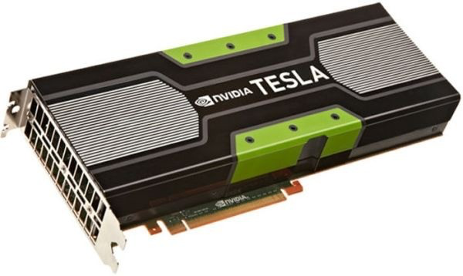
Big Data & Deep Learning
Neural Networks with many layers trained on large amounts of data
Requires high speed parallel computing
Typically using GPU (Graphic Processing Unit)

Slide 29
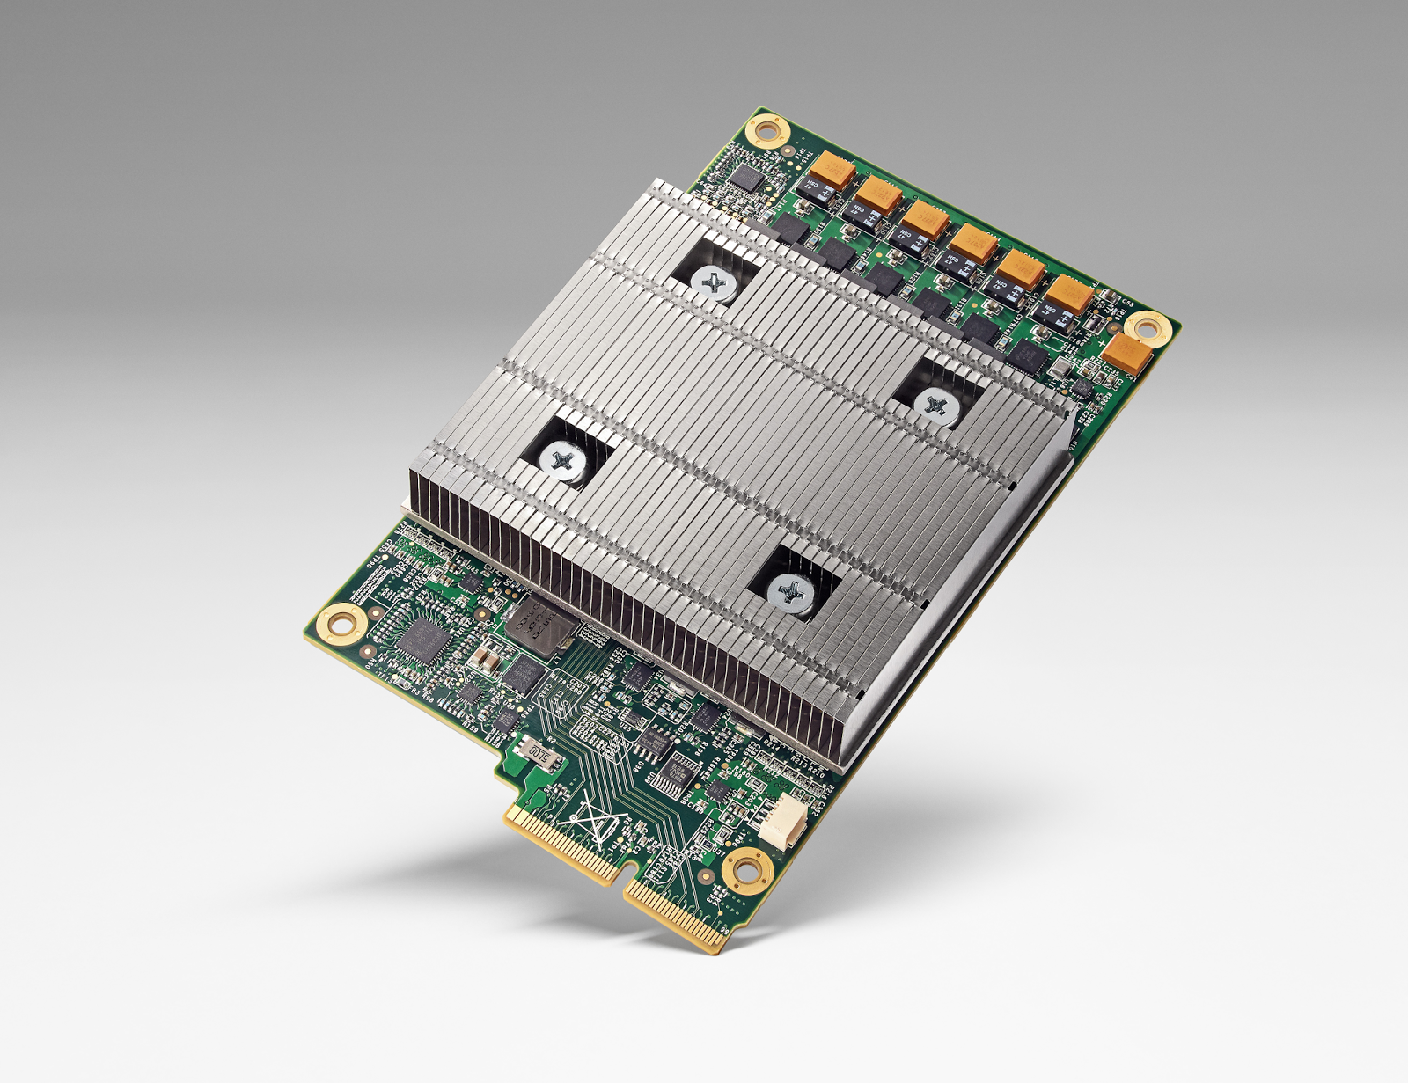
Big Data & Deep Learning
Google built TPU (Tensor Processing Unit)
10x better performance per watt
half-precision floats
Advances Moore's Law by 7 years

Slide 30
AlphaGo
TPU can fit into a hard drive slot within the data center rack and has already been powering RankBrain and Street View

Slide 31
Unreasonable Effectiveness of Data
Halevy, Norvig, and Pereira argue that we should stop acting as if our goal is to author extremely elegant theories, and instead embrace complexity and make use of the best ally we have: the unreasonable effectiveness of data.
A simpler technique on more data beat a more sophisticated technique on less data.
Language in the wild, just like human behavior in general, is messy.

Slide 32
Scientific Dispute: is it science?
Prof. Noam Chomsky, Linguist, MIT
Peter Norvig, Director of research, Google

Slide 33
Why to study human language?

Slide 34
AI is fascinating since it is the only discipline where the mind is used to study itself
Luigi Stringa, director FBK

Slide 35
Language and Intelligence
“Understanding cannot be measured by external behavior; it is an internal metric of how the brain remembers things and uses its memories to make predictions”.
“The difference between the intelligence of humans and other mammals is that we have language”.
Jeff Hawkins, “On Intelligence”, 2004

Slide 36
Hawkins’ Memory-Prediction framework
The brain uses vast amounts of memory to create a model of the world. Everything you know and have learned is stored in this model.
The brain uses this memory-based model to make continuous predictions of future events.
It is the ability to make predictions about the future that is the crux of intelligence.

Slide 37
Difference Between Data Science, Machine Learning and AI
Post from David Robinson
Statistics is used to find correlations in data
Machine Learning is used to learn a model from examples to make predictions
Artificial Intelligence uses ML to extract a model of a human intelligence ability, to perform actions
Humans in the loop are involved in providing examples of human behavior (e.g. annotating data, evaluating results)
Data Science uses statistical analysis of data to produce insights from statistical correlations
It uses humans in the end, who sift among those correlations hints to produce the insights
The intelligence lays in humans that interpret the output of statistical analysis

Slide 38
Thirty Million Words
The number of words a child hears in early life will determine their academic success and IQ in later life.
Researchers Betty Hart and Todd Risley (1995) found that children from professional families heard thirty million more words in their first 3 years
http://www.youtube.com/watch?v=qLoEUEDqagQ

Slide 39
Linguistic Applications
So far self referential: from language to language
Classification
Extraction
Summarization
More challenging:
Derive conclusion
Perform actions

Slide 40
Natural Language Understanding is difficult
The hidden structure of language is complex and highly ambiguous
Fed raises interest rates 0.5% in effort to control inflation
(NYT headline 5/17/00)
Slide by C. Manning

Slide 41
Where are the ambiguities?
Slide by C. Manning

Slide 42
Newspaper Headlines
Minister Accused Of Having 8 Wives In Jail
Juvenile Court to Try Shooting Defendant
Teacher Strikes Idle Kids
China to Orbit Human on Oct. 15
Local High School Dropouts Cut in Half
Red Tape Holds Up New Bridges
Clinton Wins on Budget, but More Lies Ahead
Hospitals Are Sued by 7 Foot Doctors
Police: Crack Found in Man's Buttocks

Slide 43
Reference Resolution
U: Where is The Green Hornet playing in Mountain View?
S: The Green Hornet is playing at the Century 16 theater.
U: When is it playing there?
S: It’s playing at 2pm, 5pm, and 8pm.
U: I’d like 1 adult and 2 children for the first show. How much would that cost?
Knowledge sources:
Domain knowledge
Discourse knowledge
World knowledge

Slide 44
NLP is hard
Natural language is:
highly ambiguous at all levels
complex and subtle use of context to convey meaning
fuzzy?, probabilistic
involves reasoning about the world
a key part of people interacting with other people (a social system):
persuading, insulting and amusing them
But NLP can also be surprisingly easy sometimes:
rough text features can often do half the job

Slide 45
Hidden Structure of Language
Going beneath the surface…
Not just string processing
Not just keyword matching in a search engine
Search Google on “tennis racquet” and “tennis racquets” or “laptop” and “notebook” and the results are quite different … though these days Google does lots of subtle stuff beyond keyword matching itself
Not just converting a sound stream to a string of words
Like Nuance/IBM/Dragon/Philips speech recognition
To recover and manipulate at least some aspects of language structure and meaning

Slide 46
About the Course
Assumes some skills…
basic linear algebra, probability, and statistics
decent programming skills
willingness to learn missing knowledge
Teaches key theory and methods for Statistical NLP
Useful for building practical, robust systems capable of interpreting human language
Experimental approach:
Lots of problem-based learning
Often practical issues are as important as theoretical niceties

Slide 47
Experimental Approach
Formulate Hypothesis
Implement Technique
Train and Test
Apply Evaluation Metric
If not improved:
Perform error analysis
Revise Hypothesis
Repeat

Slide 48
Program
Introduction
History
Present and Future
NLP and the Web
Mathematical Background
Probability and Statistics
Language Model
Hidden Markov Model
Viterbi Algorithm
Generative vs Discriminative Models
Linguistic Essentials
Part of Speech and Morphology
Phrase structure
Collocations
n-gram Models
Word Sense Disambiguation
Word Embeddings
Preprocessing
Encoding
Regular Expressions
Segmentation
Tokenization
Normalization

Slide 49
Program
Machine Learning Basics
Deep Learning
Tools and Libraries
Introduction to Python
NLTK
Theano/Keras
TensorFlow
Text Classification and Clustering
Spam detection
Tagging
Part of Speech
Named Entity
Named Entity Linking
Sentence Structure
Constituency Parsing
Dependency Parsing
Sentiment Analysis
Lexical Resources
Sentiment Classification
Opinion Extraction

Slide 50
Exam
Project

Slide 51
Previous Year Projects
Participation to Evalita 2011
Task POS + Lemmatization: 1st position
Task Domain Adaptation: 1st position
Task SuperSense: 1st position
Task Dependency Parsing: 2nd position
Task NER: 3rd position
SemEval 2012
Sentiment Analysis on tweets
Participation to Evalita 2014
Sentiment Analysis on tweets
Disaster Reports in Tweets
Participation to Evalita 2016
Task POS on Tweets:
Task Sentiment Polarity on Tweets:
Task Named Entity Extraction and Linking on Tweets
Participation to Evalita 2018
Task ABSITA on hotel reviews
Fujtsu NLP Grand Challenge
Winner

Slide 52
Books
D. Jurafsky, J.H. Martin, Speech and Language Processing. 3nd edition, Prentice-Hall, 2018.
S. Bird, E. Klein, E. Loper. Natural Language Processing with Python.
C. Manning, H. Schutze. Foundations of Statistical Natural Language Processing. MIT Press, 2000.
I. Goodfellow, Y. Bengio, A. Courville. Deep Learning. MIT Press, 2016.

