Slide 1
Minimal Spanning Trees
Chapter 23
Cormen Leiserson Rivest&Stein:
Introduction to Algorithms

Slide 2
Minimal Spanning Trees
Weighted Graphs G(V, E, w)
W: E R
If w=1 for all edges BFS is the solution.
The MST is the way of connecting n vertices at minimal cost of connections.
Two greedy algorithms : Kruskal
Prim

Slide 3
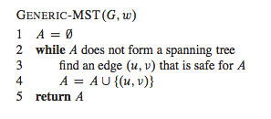
Minimal Spanning Trees
First a generic method utilized by the two algorithms:
Prior of each iteration, A is a subset of a MST
Determine a safe edge (u,v): A U (u,v) is still a subset of a MST.

Slide 4
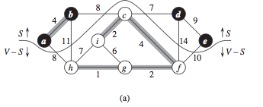
Minimal Spanning Trees
S vertices in MST (black). V-S vertices to be selected. The line is the cut. Light vertices crossing the cut can be selected for the MST.
They are safe!

Slide 5
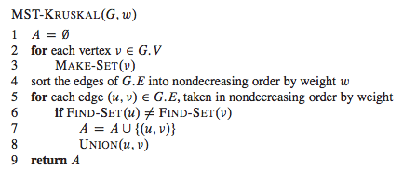
Kruskal Algorithm for MST
Uses a disjoint-set data structure to maintain several disjoint sets of elements. FIND-SET(u) returns a representative element of the set containing u.
(Disjoint set forest chapter. 21)

Slide 6
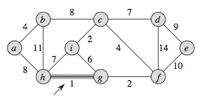
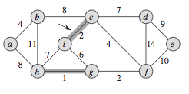
Kruskal Algorithm for MST

Slide 7
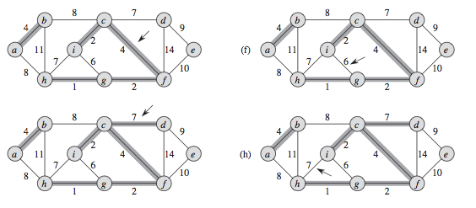
Kruskal Algorithm for MST

Slide 8
Kruskal Algorithm for MST

Slide 9
Kruskal Algorithm complexity
Complexity depends on how we implement the disjoint-set data structure.
(Disjoint set forest chapter. 21.3)
Sorting of the edges O(E log E)
Loop 5-8 O(E) FIND-SET and UNION operations on the disjoint set forest.
| V | operations of MAKE-SET
In total the loop takes O((V +E) α(V)) time α is very slowly growing function. Since E≥V-1 and α(V)=O(logV) = O(logE) the loop takes O(E log E).
In total the Kruskal alg. takes O(E log E) = O(E log V)

Slide 10
PRIM algorithm for MST
Starts from an arbitrary vertex r the root.
The set A forms a single tree at any step.
All vertices not in the spanning tree form a min Heap Q based on the minimum weight of any edge connecting v and the tree. Value v.key.
The termination condition is that the heap Q is empty, that means that all vertices have been connecte to the MST.

Slide 11
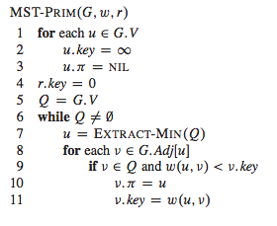
PRIM algorithm for MST
The parent in the MST

Slide 12
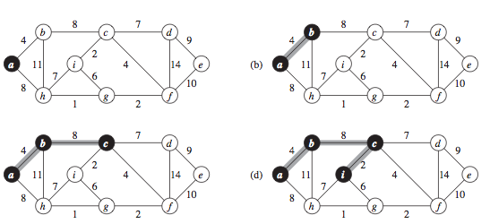
PRIM algorithm for MST

Slide 13
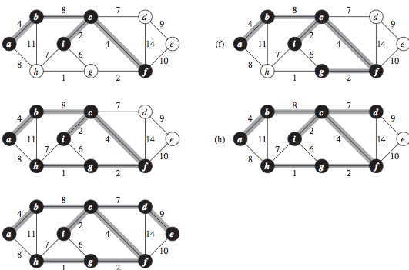
PRIM algorithm for MST

Slide 14
Loop 6-11 invariant

Slide 15
Complexity PRIM algorithm
Row 1-5 : Build min heap takes O(V)
The while loop is executed O(V) times and EXTRACT-MIN take O(log V) time hence in totla O(VlogV)
The for loop is executed O(E) in total and the last operation is a DECREASE-KEY operation O(logV).
Prims algorithm takes O(VlogV + ElogV) = O(E logV) the same as Kruskal algortihm! It can be improved to:
O(E + V log V)
using for Q the data structure Fibonacci Heap

