Slide 1

Symfony2 Tutorial
Giuseppe Attardi
Alexios Tzanetopoulos

Slide 2
What is Symfony2?
PHP Web Application Framework that provides:
  Object Oriented programming style through ORM
  a MVC GUI
  Automatic code generation
  a collection of components and third-party libraries
  configuration and a "glue" library that ties all of these pieces together

Slide 3
Difference between Web Framework and CMS
A web (application) framework is a lower level, generic toolkit for the development of web applications
A system managing and processing data while exposing it's data and services to users and machines via the http protocol
A CMS is one type of such applications: a system to manage content shown in websites
CMS are built on top of a WAF
Drupal 7 has its own CMS, Drupal 8 uses Symfony2

Slide 4
Problems Solved by Symfony2
Data persistence (via Doctrine)
Security
Forms
Validation
Templating
Autoloading
Logging
Asset Management
Routing
File+Dir Traversing
Translation
Dependency Injection
Image Manipulation
Console Tasks
Caching

Slide 5
Performance
Symfony 2.0 is about 3 times faster than Zend Framework 1.10, while taking up 2 times less memory

Slide 6
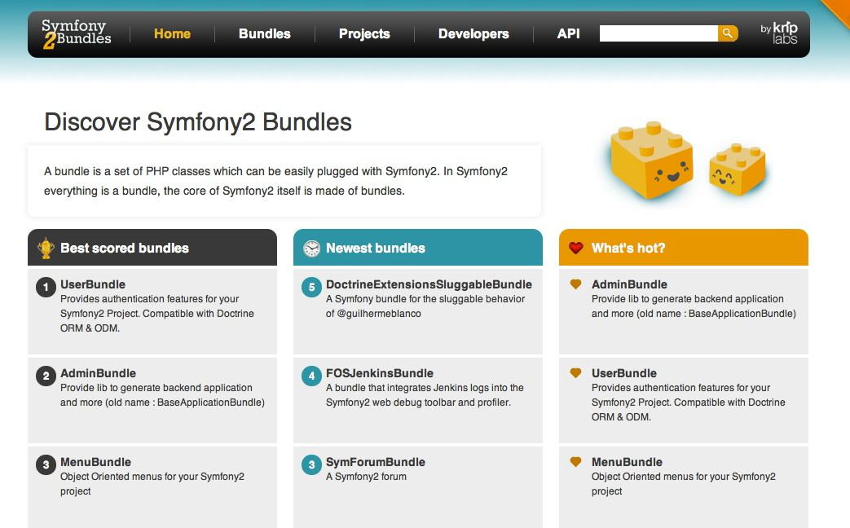
Symfony Bundles

Slide 7
What is Model-View-Controller?
MVC is a software architecture that separates the representation of information from the user’s interaction with it
  the model represents the state of the application
  a view displays a representation of the model
  the controller mediates input, converting it to commands for the model or view

Slide 8
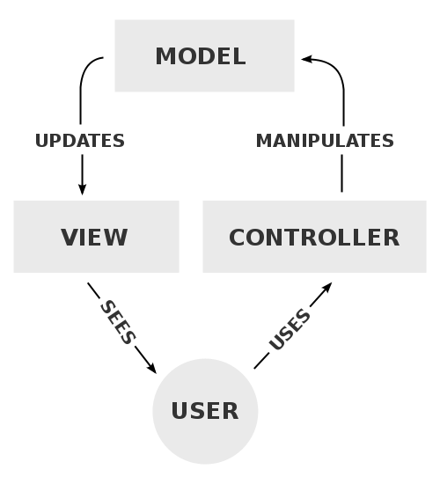
Interactions

Slide 9
Component Interactions
  A controller sends commands:
    to the model to perform actions that may update the model state
    to the view to change the view’s presentation of the model (e.g., by scrolling through a document).
  After a model update the model notifies its associated views and controllers, so that the views can produce updated output, and the controllers to change the available set of commands
  A view requests from the model information needed to generate an output representation

Slide 10
ORM (Object Relational Mapping)
A technique for converting data in a Relational DB into Objects and vice versa
The program manipulates objects which are persisted typically as a row in a table and read back from the table
The attributes of an object correspond to columns
A table is mapped to a repository object that represent the collection of objects
Queries are submitted to a repository and return a list of objects or a cursor on such list

Slide 11
Symfony2 Benefits
A Framework simplifies development by providing structure and reusable modules
Fast and less gready
Allows choosing which ORM to use
Web Debug Toolbar
Plentiful documentation and tutorials
Drupal 8 uses Symfony instead of its own framework

Slide 12
Cons
Requires command line (troll)
Not easy to learn

Slide 13
Flat PHP (blog posts page)
<?php // index.php
$link = mysql_connect('localhost', 'myuser', 'mypassword');
mysql_select_db('blog_db', $link);
$result = mysql_query('SELECT id, title FROM post', $link); ?>
<!DOCTYPE html>
<html><head>
<title>List of Posts</title> </head> <body>
<h1>List of Posts</h1>
<ul>
<?php while ($row = mysql_fetch_assoc($result)): ?>
<li><a href="/show.php?id=<?php echo $row['id'] ?>">
<?php echo $row['title'] ?> </a>
</li>
<?php endwhile; ?>
</ul>
</body> </html>
<?php mysql_close($link); ?>

Slide 14
Result?
No error-checking
Poor organization
Difficult to reuse code

Slide 15
Hands on Symfony2

Slide 16
1st step - Installation
Download from http://symfony.com/download (standard version)
Unpack folder in /var/www
Test it @ http://localhost/Symfony/web/app_dev.php
Go to folder
  > cd Symfony

Slide 17
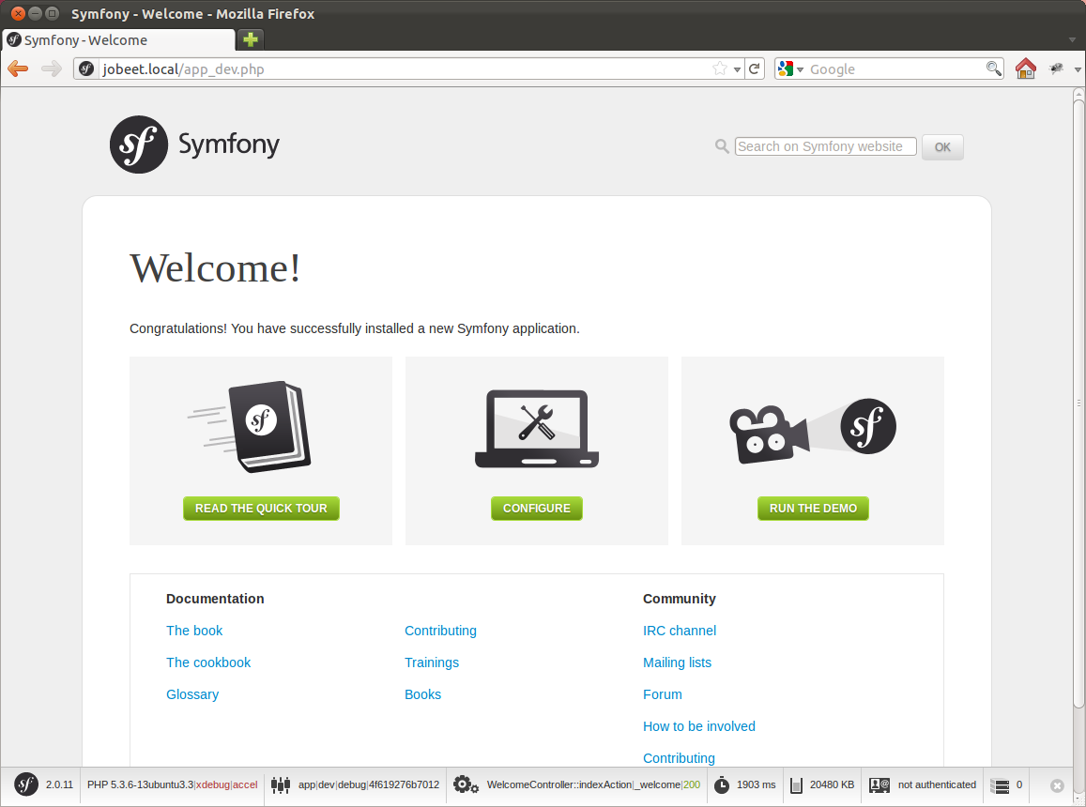

Slide 18
2nd step - Create Application Bundle
A Symfony2 project is made up of bundles
Create bundle:
> app/console generate:bundle --namespace=Rosi/PeopleBundle
--format=annotation
Generates code in directory
  src/Rosi/PeopleBundle

Slide 19
Folder Structure
  Entity
 Person.php
 PersonRepository.php
 Category.php
  Controller
 PersonController.php
  Form
 PersonType.php
  Resources
  views
  Person
 new.html.twig
 edit.html.twig
 index.html.twig
Model
Controller
Views

Slide 20
Folder Structure
  Resources
  public
  css
  images
  js
 config
 routing.yml
 services.xml
 validation.yml

Slide 21
3rd step - The Data Model
Edit the parameters file
;app/config/parameters.ini
[parameters]
database_driver = pdo_mysql
database_host = localhost
database_name = symfony
database_user = root
database_password = password
Use doctrine in command line to auto-create the database in mysql:
> app/console doctrine:database:create

Slide 22
3rd step - The Data Model
Mapping to column
class Person {
/** @ORM\Column(name="id", type="integer")
* @ORM\Id
* @ORM\GeneratedValue(strategy="AUTO")
*/
private $id;
/** @ORM\Column(name="Name", type="string", length=30) */
public $name;
/** @ORM\Column(name="room", type="string", length=30) */
public $room;
…
}

Slide 23
3rd step - The Data Model - Repository
class PersonRepository extends EntityRepository {
public function findAllOrderedByName() {
return $this->getEntityManager()
->createQuery(
'SELECT p FROM Person p
ORDER BY p.Name ASC‘)
->getResult();
}

Slide 24
3rd Step – Data Model - Query
/**
* Delete person with id $id.
*/
public function remove($id)
{
$this->createQueryBuilder('p')
->delete('RosiPeopleBundle:Person', 'p')
->where('p.id = :id')
->setParameter('id', $id)
->getQuery()
->execute();
}

Slide 25
3rd step - The Data Model - Associations
/**
* @ORM\ManyToOne(targetEntity="Category", inversedBy="members")
* @ORM\JoinColumn(name="category_id",
referencedColumnName="id")
*/
public $category;
/** @ORM\ManyToOne(targetEntity="Department",
inversedBy="members")
* @ORM\JoinColumn(name="department_id",
referencedColumnName="id")
*/
public $department;

Slide 26
3rd step - The Data Model
Doctrine generates the accessor methods:
> app/console doctrine:generate:entities RosiPeopleBundle
public function getName() {
return $this->name;
}

Slide 27
3rd step - The ORM
We can ask Doctrine to create our database tables (or to update them to reflect our setup) with the command:
> app/console doctrine:schema:update --force
Updating database schema...
Database schema updated successfully! "7" queries were executed

Slide 28
4th step - Initial Data
> mysql –u root -p
use symfony;
INSERT into Category VALUES ("PO");
INSERT into Category VAUES ("PA");
INSERT into Person VALUES ("Albano", "2743");
INSERT into Person VALUES ("Attardi”, "2744");

Slide 29
Request Processing
Request
Bootstrap
Controller
Template
Response

Slide 30
5th Step – Generate CRUD
> app/console doctrine:generate:crud
--entity="RosiPeopleBundle:Person“
--with-write
Generates controller PersonController that provides methods:
  indexAction
  newAction
  showAction
  editAction
  deleteAction

Slide 31
6th step - The Routing
Associates URLs to controller methods
Example:
symfony/app.php/person/1/edit
; Rosi/PeopleBundle/Resource/config/routing.yml
rosi_person_edit:
pattern: /person/{id}/edit
defaults: { _controller: RosiPeopleBundle:Person:edit }

Slide 32
Routing Annotation
Can be provided in annotation to the method
Modifying app/config/routing.yml
/**
* Displays a form to edit an existing Person entity.
*
* @Route("/{id}/edit", name=“rosi_person_edit")
* @Method("GET")
* @Template()
*/
public function editAction($id) { }
rosi_people:
resource: "@RosiPeopleBundle/Controller/PersonController.php"
type: annotation

Slide 33
5th step - The Routing
Edit the rosi_person_show route from the job.yml file:
# src/Ens/JobeetBundle/Resources/config/routing/job.yml
# ...
ens_job_show:
pattern: /{company}/{location}/{id}/{position}
defaults: { _controller: "EnsJobeetBundle:Job:show" }

Slide 34
6th step - Route Debugging
See every route in your application:
Or a single route:
> app/console router:debug
> app/console router:debug rosi_person_show

Slide 35
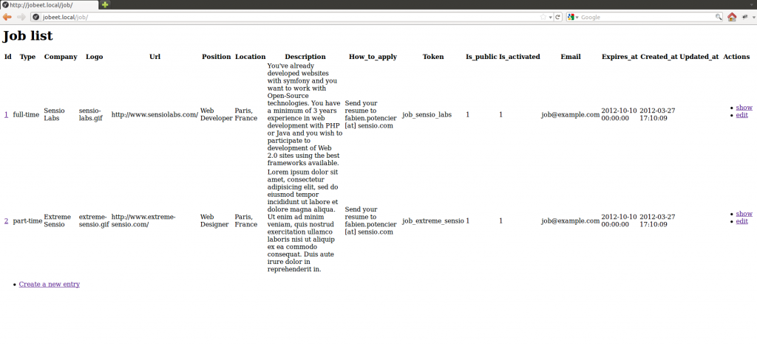

Slide 36
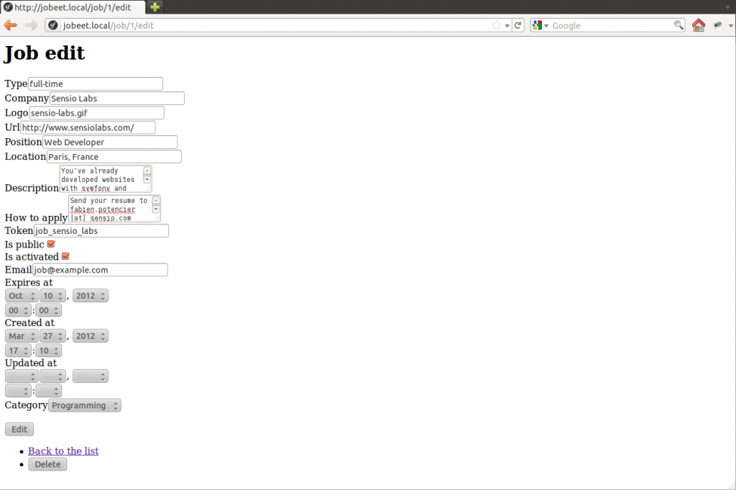

Slide 37
So far?
Barely written PHP code
Working web module for the job model
Ready to be tweaked and customized
Remember, no PHP code also means no bugs!

Slide 38
7th step - The View
Create the file layout.html.twig in the directory:
src/Rosi/PeopleBundle/Resources/views/

Slide 39
7th Step – Twig Templates
Variables:
Blocks
{{ var }}
{{ var | upper }}
{{ var | raw }}
{{ object.property }}
{{ true ? ‘yes’ : ‘no’ }}
{% if foo is ‘bar’ %}
...
{% else %}
...
{% endif %}

Slide 40
Twig Templates
Extends:
Notice: there is no PHP code in Twig
Full separation between logic and presentation
{% extends "Bundle::layout.html.twig" %}

Slide 41
Twig Layouts
A base layout defines blocks
Each block can have a default value
{% block header %}
<h1>Welcome!</h1>
{% endblock %}
header
side
bar
content

Slide 42
Twig Layouts
A child layout extends the parent
And overrides its blocks
{% block header %}
{{ parent() }} back
{% endblock %}
header
side
bar
content

Slide 43
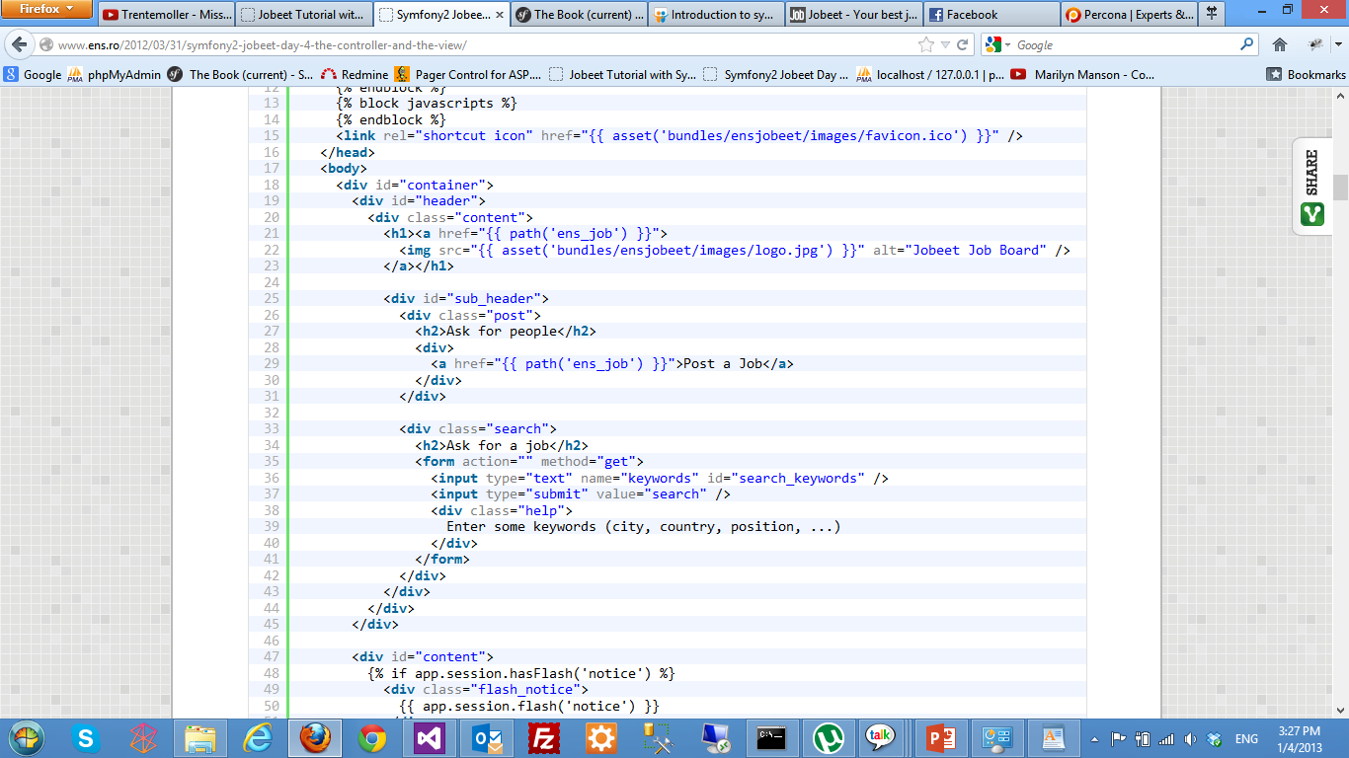

Slide 44
7th step - The View
Tell Symfony to make them publicly available:
Creates symlink:
> app/console assets:install web --symlink
web/bundles/rosi -> src/Rosi/PeopleBundle/Resources/public

Slide 45
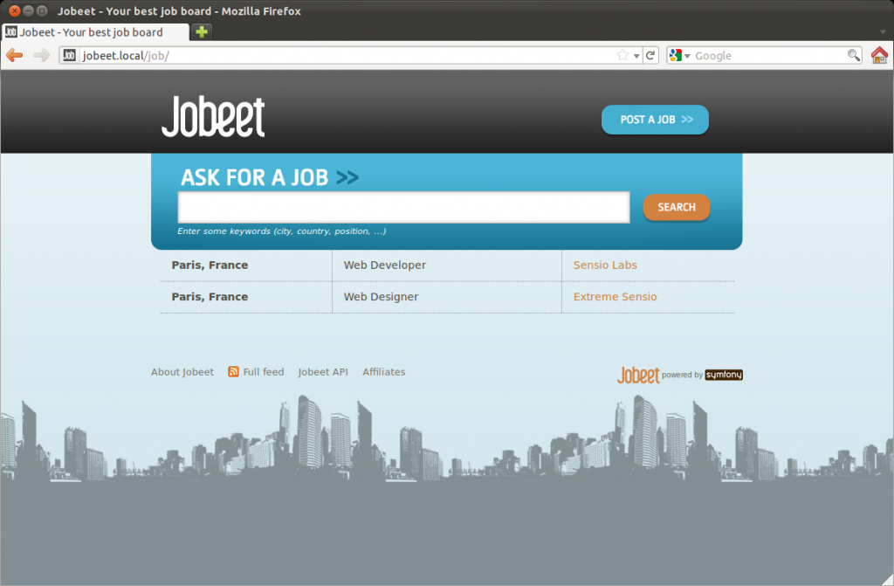

Slide 46
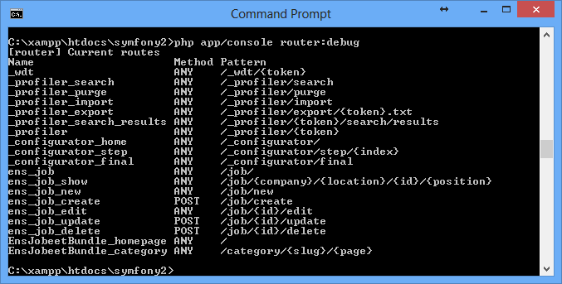

Slide 47
6th step - Testing
2 methods:
Unit tests and Functional tests
Unit tests verify that each method and function is working properly
Functional tests verify that the resulting application behaves correctly as a whole

Slide 48
7th and last step - Bundles
Bundles are like modules in Drupal
Even symfony2 is a bundle itself
Many useful bundles such as
  FOSUserBundle (user management)
  SonataAdminBundle (Admin Generator)
  FOSFacebookBundle (Integrate the Facebook)
  PagefantaBundle (paginate)

Slide 49
Composer
Manage bundle installation and update
Example:
  Include bundle in composer.json:
"require": {
"apy/datagrid-bundle": "dev-master"
  Invoke composer:
> php composer.phar update apy/datagrid-bundle

Slide 50
Import from DB

Slide 51
SqlServer driver
; app/config/parameters.yml
parameters:
database_driver: pdo_dblib
database_host: 131.114.3.27
database_port: null
database_name: Dipartimento
database_user: INFORMATICA\attardi
database_password: password

Slide 52
Install driver
See https://github.com/intellectsoft-uk/MssqlBundle
> php composer.phar require "isoft/mssql-bundle:master-dev"
> sudo apt-get install php5-sybase
Add to vendor/doctrine/dbal/lib/Doctrine/DBAL/DriverManager.php
'pdo_dblib' => 'Realestate\DBAL\Driver\PDODblib\Driver',
# check connection
# Edit /etc/freetds/freetds.conf
# tds version = 7.0
> sudo apt-get install freetds-bin
> tsql -H compass2.di.unipi.it -U INFORMATICA\\attardi -p 1433

Slide 53
Generate Bundle
> app/console generate:bundle
--namespace=Compass/DipBundle
--bundle-name=Compass\DipBundle
Fixes to MssqlBundle
Rename uniqueidentifier -> timestamp in:
  vendor/isoft/mssql-bundle/Realestate/MssqlBundle/RealestateMssqlBundle.php
  vendor/isoft/mssql-bundle/Realestate/MssqlBundle/Types/UniqueidentifierType.php

Slide 54
Generate Classes
Step 1
> app/console doctrine:mapping:import
--em=compass2 –force
CompassDipBundle annotation
Step 2
> app/console doctrine:generate:entities CompassDipBundle

Slide 55
CRUD for imported tables
> app/console doctrine:generate:crud
--entity="CompassDipBundle:GenPersone“
--with-write --route-prefix=/dept/person
Change field GenPerTelSta2::ptsId to id
> app/console doctrine:generate:crud
--entity="CompassDipBundle:GenPerTelSta2“
--with-write --route-prefix=/dept/person2
> app/console doctrine:generate:crud
--entity="CompassDipBundle:GenOrganizzazione“
--with-write --route-prefix=/dept/organization

Slide 56
Write Entity for Views
Views are not imported
Write class Person, corresponding to view
PTS_V_PersoneDipartimento

Slide 57
Annotations

Slide 58
Security
/**
* @extra:Route("/hello/admin/{name}")
* @extra:Secure(roles="ROLE_ADMIN")
* @extra:Template()
*/
public function helloadminAction($name)
{
return array('name' => $name);
}

Slide 59
Caching
/**
* @extra:Route("/hello/{name}“)
* @extra:Template()
* @extra:Cache(maxage="86400")
*/
public function helloAction($name) {
return array('name' => $name);
}

Slide 60
Validation
RosiPeopleBundle\Entity\Person:
properties:
name:
- Length: {max:30, maxMessage: “Il nome non può superare 30 caratteri."}
- NotBlank: {message: "Inserire il nome."}
category:
- NotBlank: {message: "Indicare una categoria."}

Slide 61
Questions
Manual
  http://symfony.com/doc/current/book/index.html
Tutorial
  http://www.ens.ro/2012/03/21/jobeet-tutorial-with-symfony2/

