Slide 1
javascript in practice
Davide Morelli

Slide 2

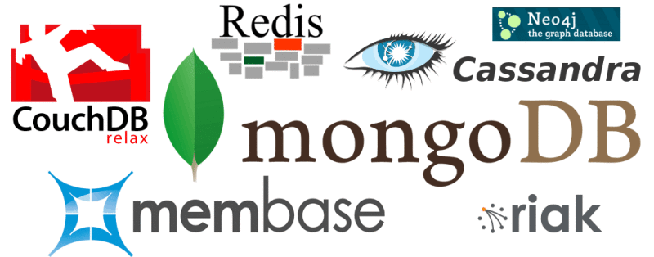
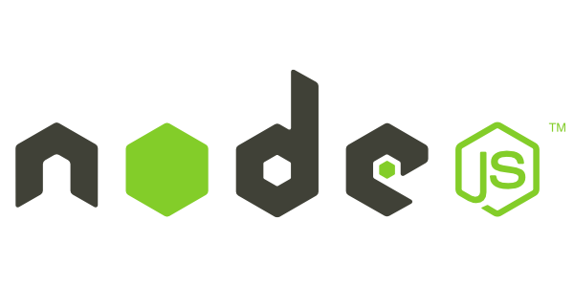
one language to rule them all
Browser: JavaScript
NoSQL: JSON
Server: JavaScript

Slide 3
TODO list
let’s build a TODO list
just:
  list items
  add item
  complete item
all AJAX/AJAJ

Slide 4
TODO list
nodejs + jQuery + mongoDB
nodejs:
  build on top of Google's V8 VM
    https://code.google.com/p/v8/
    developed by Google for Chrome
    open source
    compiles to machine code
    https://developers.google.com/v8/design

Slide 5
setup the server
go to http://nodejs.org and install
go to http://www.mongodb.org and install
run mongod
run mongo, create a db
  use todoapp

Slide 6
NodeJS helloworld
create a file helloworld.js
      var http = require('http');
      var server = http.createServer(function(req, res) {
      res.writeHead(200);
      res.end('Hello World!');
      });
      server.listen(8080);
run it
  node helloworld.js

Slide 7
nodeJS: the module system
create a file hello.js
      exports.world = function() {
      console.log('Hello World');
      }
use the module
      var hello = require('./hello');
      hello.world();
http is a module, createServer is an exposed function

Slide 8
functions as parameters
createServer takes 1 parameter:
  a function that handles requests
        var http = require("http");
        function onRequest(request, response) {
        response.writeHead(200, {"Content-Type": "text/plain"});
        response.write("Hello World");
        response.end();
        }
        http.createServer(onRequest).listen(8888);

Slide 9
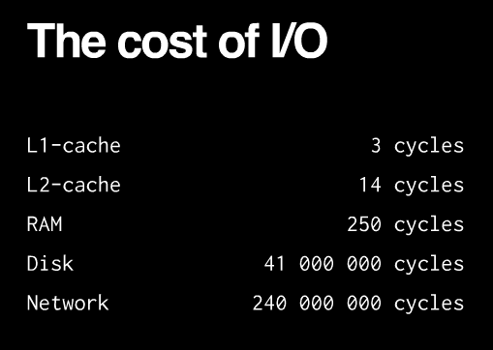
Why passing functions around?
I/O is expensive

Slide 10
Why passing functions around?
I/O is expensive
  synchronous: one at a time. simple. what if a request takes a long time to complete?
  fork a new process: heavy load leads to hundreds of processes
  threads: requests spawn threads (Apache). memory expensive. multithreading is complicated.

Slide 11
Why passing functions around?
I/O is expensive
  nodejs:
    single thread for your code
    I/O runs in parallel
    your code gets called when I/O is ready
    use callbacks everytime you have to wait
    node expects your code to finish quickly
      use WebWorker or separate process if not

Slide 12
Event-driven asynchronous callbacks
event loop
  at an I/O call nodejs will:
    save your callback
    start the I/O call asynchronously
    return control to the nodejs environment (serving the next request)
  all user code is on same thread!
  in the background I/O calls on separate threads
  internally uses libev for the event loop

Slide 13
node: modules
package manager: npm
install express globally:
    npm install -g express
create a website with express template
  we’ll use the jade template engine
  express --sessions --css stylus –ejs todoapp
install dependancies
    cd todoapp
    npm install

Slide 14
let’s prepare the stubs
list items:
      app.get('/list', function(req, res){
      res.json([{'id': ‘A’, 'text':'compra pane'}, {'id’:’B’, 'text': 'compra latte'}]);
      });
add item:
      app.post('/add', function(req, res){
      console.log("add " + req.body.text);
      res.end();
      });
complete item:
      app.post('/complete', function(req, res){
      console.log("complete " + req.body.id);
      res.end();
      });

Slide 15
let’s test the stubs
list items:
curl http://localhost:3000/list
add item:
      curl -X POST --data "text=ciao" http://localhost:3000/add
complete item:
curl -X POST --data "id=A" http://localhost:3000/complete

Slide 16
let’s prepare the client
load jQuery. add this to the jade layout header
    script(src='http://code.jquery.com/jquery-1.8.1.js')
    script(src='/javascripts/todoapp.js’)
add an empty todoapp.js file in /public/javascripts
and modify index.jade to
      h1= title
      p Things to do:
      ul#list
      div.additem
      form
      input(id="text", type="text", name="text")
      input(id="add_submit", type="button", value="add")

Slide 17
Client
several frameworks:
  JQuery, Dojo, MooTools, Prototype, Raphael, etc..
  Why?
    uniform layer on browser’s craziness
    easier DOM manipulation and event handling
    easier AJAX/AJAJ
    easier RIA

Slide 18
jQuery
see slides..
.. open browser developer console and try

Slide 19
let’s write the client
add to todoapp.js: show item
  function addTodoElement(TODOElement) {
  $('#list').append("<li id='" + TODOElement.id + "'>"+TODOElement.text+" - <a href='javascript:complete(\""+ TODOElement.id + "\")'>complete</a></li>");
  }

Slide 20
let’s write the client
add to todoapp.js: complete an item
    function complete(id) {
    $.post( "/complete", {'id':id}, function( data ) {
    loadList();
    });
    }

Slide 21
let’s write the client
add to todoapp.js: add an item
    function add(text) {
    $.post( "/add", {'text':text}, function( data ) {
    loadList();
    });
    }

Slide 22
let’s write the client
add to todoapp.js: load the list
    function loadList() {
    // clear the list
    $('#list').empty();
    // load list from server
    $.getJSON("/list", function (data) {
    for (var i = 0; i < data.length; i++) {
    addTodoElement(data[i]);
    };
    });
    }

Slide 23
let’s write the client
add to todoapp.js: first time load
    $(document).ready(function(){
    loadList();
    $("#add_submit").click(function(){
    add($("#text").val());
    })
    });

Slide 24
time to implement the server
let’s connect to the db
let’s add mongoose:
  http://mongoosejs.com
  npm install mongoose (or add it to the packages.json file)
add this to app.js to connect to the db
    var mongoose = require('mongoose');
    mongoose.connect('mongodb://localhost/todoapp');

Slide 25
the db schema
var todoItemSchema = mongoose.Schema({
text: String,
completed: Boolean
});
var todoItem = mongoose.model('TODOItem', todoItemSchema);

Slide 26
implement /list
app.get('/list', function(req, res){
todoItem.find({completed: false}, function(err, todoitems) {
if (err) {
res.json([]);
} else {
var items = [];
for (var i = 0; i < todoitems.length; i++) {
var todoitem = todoitems[i];
items.push({
id: todoitem._id,
text: todoitem.text
});
};
res.json(items);
}
});
});

Slide 27
implement /add
app.post('/add', function(req, res){
var text = req.body.text;
console.log("adding " + text);
var newItem = new todoItem();
newItem.text = text;
newItem.completed = false;
newItem.save(function (e) {
console.log("added " + text);
res.end();
});
});

Slide 28
implement /complete
app.post('/complete', function(req, res){
var id = req.body.id;
console.log("calling complete " + id);
todoItem.findOne({_id: id}, function (err, item) {
if (err) {
console.log("found element with id " + id);
res.end();
} else {
item.completed = true;
item.save(function (err, item) {
if (err) {
console.log("error saving element with id " + id);
} else {
console.log("saved element with id " + id);
}
res.end();
})
}
});
});

Slide 29
TODO app
source code available at
  https://github.com/morellid/pa_todoapp/

Slide 30
what’s wrong?
function findTotals(){
var elements = [];
db.customers.find({ country: 'UK' }, function(err, customers) {
for ( var i=0; i<customers.length; i++) {
db.cart.find({ customerid: customer[i].id}, function (err, cart){
for (var j = 0; j<cart.length; j++) {
elements.push(cart[j].total);
}
});
}
return elements;
});
}

Slide 31
solution
function findTotals(){
db.customers.find({ country: 'UK' }, function(customers) {
var elements = [];
var iterator = function(i) {
if (i>=customers.length) {
return elements;
}
db.cart.find({ customerid: customer[i].id}, function (cart){
for (var j = 0; j<cart.length; j++) {
elements.push(cart[j].total);
}
iterator(i+1);
});
}
iterator(0);
});
}
closure
recursive call

