Slide 1
Advanced Algorithms for Massive Datasets
Basics of Hashing

Slide 2
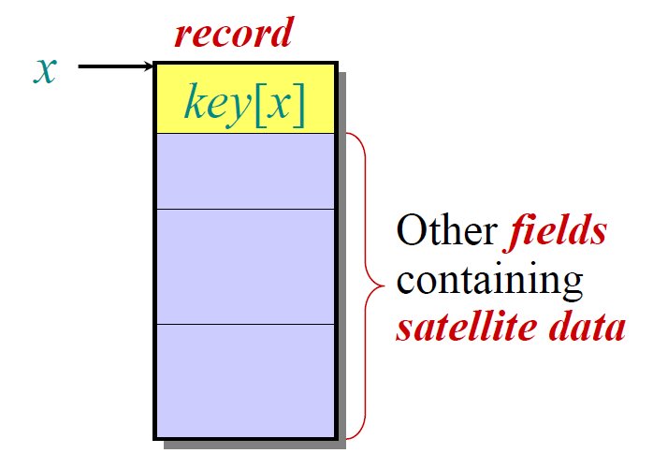
The Dictionary Problem
Definition. Let us given a dictionary S of n keys drawn
from a universe U. We wish to design a (dynamic) data
structure that supports the following operations:
membership(k) → checks whether k є S
insert(k) → S = S U {k}
delete(k) → S = S – {k}

Slide 3
Collision resolution: chaining

Slide 4
Key issue: a good hash function
Basic assumption: Uniform hashing
Avg #keys per slot = n * (1/m) = n/m
= α (load factor)

Slide 5
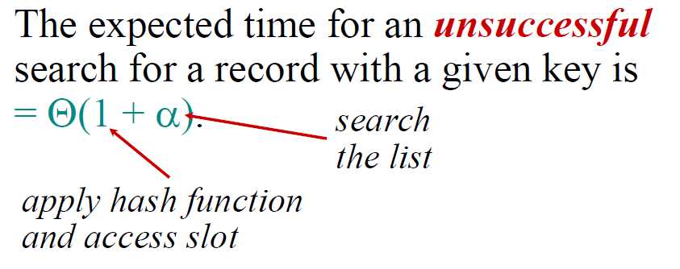
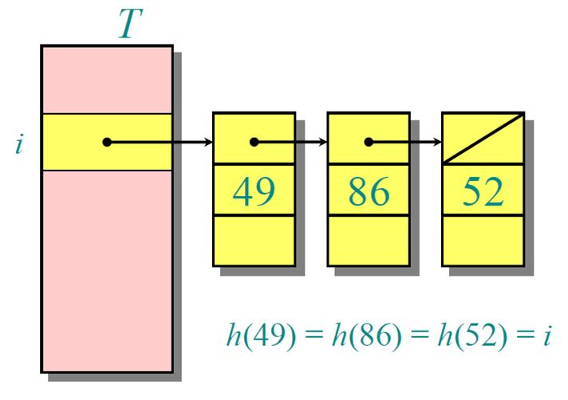
Search cost
m = Ω(n)

Slide 6
In summary...
Hashing with chaining:
O(1) search/update time in expectation
O(n) optimal space
Simple to implement
...but:
Space = m log₂ n + n (log₂ n + log₂ |U|) bits
Bounds in expectation
Uniform hashing is difficult to guarantee
Open addressing
array
chains

Slide 7
In practice
Typically we use simple hash functions:
prime

Slide 8
Enforce “goodness”
As in Quicksort for the selection of its pivot, select the h() at random
From which set we should draw h ?

Slide 9
An example of Universal hash
U = universe of keys
m = Table size
≈log₂ m
K
k₀
k₁
k₂
k_{r}
r ≈ log₂ U / log₂ m
a
a₀
a₁
a₂
a_{r}
Each a_{i} is selected at random in [0,m)
prime
not necessarily: (...mod p) mod m

Slide 10
Simple and efficient universal hash
h_{a}(x) = ( a*x mod 2^{r} ) div 2^{r-t}
0 ≤ x < |U| = 2^{r}
a is odd
Few key issues:
Consists of t bits, so m = 2^{t}
Probability of collision is ≤ 1/2^{t-1} (= 2/m)

Slide 11
Minimal Ordered Perfect Hashing
= lexicographic rank
Minimal, not minimum
m = 1.25 n
n=12 → m=15
The h₁ and h₂ are not perfect

Slide 12
h(t) = [ g( h₁(t) ) + g ( h₂(t) ) ] mod n
h is perfect and ordered, no strings need to be stored
space is negligible for h₁ and h₂ and it is = m log n, for g

Slide 13
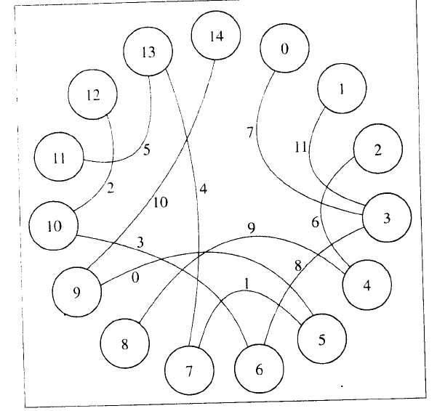
How to construct it
Term = edge, its vertices
are given by h1 and h2
All g(v)=0; then assign g()
by difference with known h()
Acyclic → ok
No-Acycl →
regenerate hashes

