Slide 1
Sentiment Analysis and Subjectivity
Giacomo Righetti, dept. of Computer Science, University of Pisa, ISTI-CNR

Slide 2
Agenda
Part I
Introduction
Motivations and Issues
User level informations
Topics
Part II
Discussion about topics
Notes:
Ci sarà una parte introduttiva e nella successiva parte saranno discussi con maggiore dettaglio i concetti introdotti
Carattere di survey
Riferimenti in bibliografia

Slide 3
Introduction
Facts vs Opinions
“Facts are objective expressions about entities, events and their properties”
“Opinions are usually subjective expressions that describe people’ sentiments, appraisals or feeling toward entities, events and their properties”
Notes:
A lot of works has been done regarding "facts“ not regarding “opinions” cause the lacks of textual evidences (but the Web has changed the situation with an ever growing number of reported opinions about different topics). Ecommerce reviews, opinions on social networks (Facebook, Twitter), Blogs

Slide 4
Motivations and Issues
Little work has been done
Little opinionated text before Web
Important to individuals and organizations
User-generated content
Large volume of data
Huge amount of sources from where opinions (and expressed sentiment) need to be searched and extracted
Automated opinion discovery and summarization needed
There is the need for Sentiment Analysis
Very promising research field
20-30 companies that offer sentiment analysis services in USA
Notes:
E’ stato fatto poco lavoro in questo campo (pochi testi di questo disponibili), ma è importante per individui e organizzazioni.
Quando vogliamo prendere decisioni ci affidiamo spesso alle opinioni altrui.
Prima ci si affidava a familiari e/o amici o si facevano opinion polls.
Trovare ed elaborare opinioni sul Web è un task difficile perchè c’è un enorme quantitativo di dati disponibile, bisogna scovare le opinioni all’interno delle pagine, e organizzarle in modo che siano utilizzabili. Quindi c’è bisogno dell’Opinion Mining.
Siccome grande interesse dal punto di vista applicativo c’è stato un grande sviluppo da parte dell’industria recentemente.
---
Come giustifico il boom accademico ?!

Slide 5
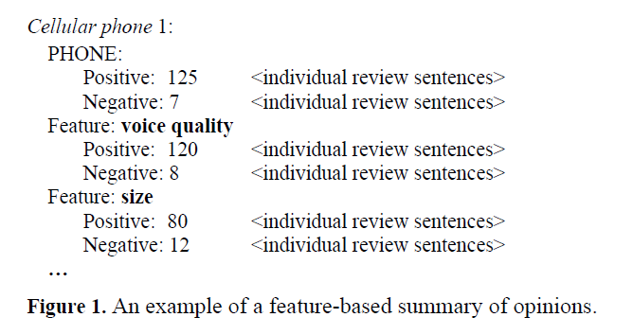
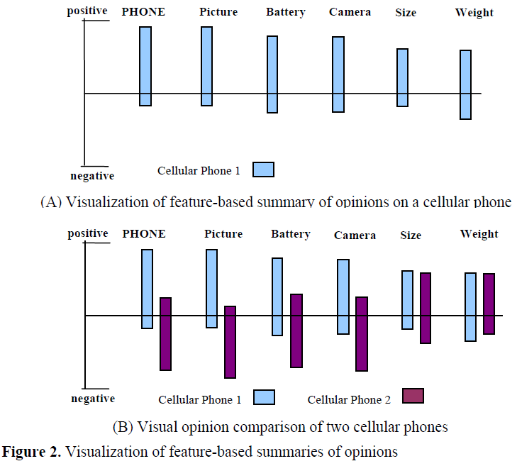
User Level informations
Notes:
Il modo in cui i dati sono presentati all’utente motiva la ricerca.
Sono molto importanti le viste aggregate, structured summaries, ottenute prendendo «unstructured natural language text» e trasformandolo in dati strutturati.
Qui possiamo vedere due tipici modi di presentare dati all’utente: feature-based summary, anche sotto forma di bar chart
«How the industrial user wants to see the results motivates the research»

Slide 6
User Level informations
Featured-based Summary
Bar Chart
Feature Buzz Summary
Object Buzz Summary
Trend Tracking
With opinions
Views
Without opinions
How we want this data to be structured?
Notes:
I precedenti grafici sono ottenuti prendendo informazione strutturata salvata in un database, facendo query e visualizzando i risultati ottenuti.
Feature buzz, mostra per ogni feature la frequenza con la quale è menzionata
Object buzz, mostra mostra la freeuqnza con la quale diversi oggetti sono citati
Trend tracking, mostra l’andamento temporale di uno dei precedenti grafici
Il punto è: come vogliamo che questi dati siano strutturati?

Slide 7
Topics
The problem of sentiment analysis
problem formalization
definitions, core concepts, issues and objectives
Sentiment and subjectivity classification
text classification problem
Feature-based sentiment analysis
further details are introduced (targets)
Sentiment analysis of comparative sentences
find out comparative sentences and preferred objects
Opinion search and retrieval
build search engines using opinionated documents
Opinion spam and utility of opinions
detecting opinion spam and assigning opinions a rank
Notes:
Il research field dell’opinion mining si focalizza sui seguenti topics:
1) We need to formalize the problem: definitions, core concepts, issues and objectives;
2) S.A as a text classification problem [document/sentence level classification, subjectivity classification];
3) Some situations require the development of a new model (which also includes targets on which opinions are expressed) in order
link opinions and sentiments to specific attributes of a topic (or a [sub]component of an object);
4) Find sentences containing comparisons between objects, and find out which is preferred by the subject;
Retrieving documents and sentences that are relevant to the query and identifying and ranking the results;

Slide 8
The problem of sentiment analysis

Slide 9
Sentiment analysis is the computational study of opinions, sentiments and emotions
expressed in text
Notes:
“Sentiment analysis (or opinion mining) is the computational study of opinions, sentiments and emotions expressed in text”
Iniziamo partendo da un esempio...

Slide 10
An example
“(1) I bought an iPhone a few days ago. (2) It was such a nice phone. (3) The touch screen was really cool. (4) The voice quality was clear too. (5) Although the battery life was not long, that is ok for me. (6) However, my mother was mad with me as I did not tell her before I bought it. (7) She also thought the phone was too expensive, and wanted me to return it to the shop. … ”
Notes:
... per introdurre il problema.
2, 3, 4 positive opinions
5, 6, 7 negative opinions

Slide 11
An example
“(1) I bought an iPhone a few days ago. (2) It was such a nice phone. (3) The touch screen was really cool. (4) The voice quality was clear too. (5) Although the battery life was not long, that is ok for me. (6) However, my mother was mad with me as I did not tell her before I bought it. (7) She also thought the phone was too expensive, and wanted me to return it to the shop. … ”
Notes:
Opinion targets, [implicit/explicit feature]
Opinion holders

Slide 12
Definitions (1)
Object
o: (T, A), where
T is a hierarchy of components
A is set of attributes of o
For example:
Cell phone
Components {battery, screen, ...}
Attributes {voice quality, size, weight}
Battery Attributes {life, size}
Hierarchical rapresentation too complex
Simplified using the term «features» for components and attributes
Notes:
Si possono esprimere opinioni su qualsiasi cosa, che riferiremo con il termine di «oggetto» nel proseguio della presentazione [da qui in poi].
An opinion can be expressed on any node and any attribute of the node.
Tuttavia studiare un testo ad un livello arbitrario di dettaglio (come implicato dalla definizione) comporta notevoli sforzi.
Di solito per rendere più agevole il compito e si usa una visione semplificata basata sul concetto di feature.
Nel seguito riferiremo sia le singole componenti, sia i singoli attributi con il termine «feature».
Rifare esempio alla luce del nuovo concetto (generic/specific opinion).
Simplified using features instead of components and attributes

Slide 13
Definitions (2)
Opinionated document d
a sequence of sentences {s₁, ..., s_{n}}
Opinion passage p<d, O, f, >
a group of consecutive sentences in d that expresses an opinion on f of the object O
Explicit / Implicit feature
if a sentence s contains a feature f (or any of its synonyms), f is said to be explicit, otherwise implicit. Each implicit feature is referred with a feature indicator
Opinion holder
who expresses the opinion
Opinion
A positive or negative view, attitude, emotion or appraisal of f from an opinion holder
The opinion orientation can be positive, negative or neutral
Notes:
An opinionated document can be a product review, a forum post, or a blog that evaluates a set of objects. [In the general case]
It can be defines as a set of sentences {s1, ..., sn}
Opinion holder is the person or organization that expresses the opinion (also know as opinion source).
---
Each implicit feature is referred by using a feature indicator

Slide 14
Feature-based sentiment analysis model (1)
Object model
given an object o:
F = {f₁, ..., f_{n}}
W_{i} = {w_{i1}, ..., w_{in}}
I_{i} = {i_{i1}, ..., i_{in}}
Opinionated document d
a set of objects {o₁, ..., o_{n}} from a set of opinion holders {h₁, ..., h_{n}}
the opinions on each object o_{j} are expressed as a subset F_{j}
Two types of opinions
direct
<o_{j}, f_{jk}, oo_{ijkl}, h_{i}, t_{l}>
comparative
expresses a relation of similarities or differences between two or more objects, and/or objects preferences of the opinion holder
Notes:
Dopo aver presentato i singoli gli elementi li mettiamo assieme per definire un modello per l’oggetto, un modello per un testo opinionato, l’obiettivo di mining che globalmente riferiamo col il termine di «Feature-based sentiment analysis model».
The f set includes the object itself as a special feature; W is the synonyms (words and phrases) finite set; I indicator finite set.
Le opinioni possono essere essere di due tipi: ...
Remark 1: simplified model
Remark 2: defined directly, defined with the effect on some othe objects
Remark 3: come identifichiamo se un testo è opinionato, cioè contiene opinioni? «Se almeno una delle sue frasi contiene opinioni» potrebbe non essere corretto perchè l’opinione potrebbe essere una citazione. Si può usare un criterio intenzionale, ossia se l’autore vuole esprimere la propria opinione usando il testo.

Slide 15
Feature-based sentiment analysis model (2)
Opinion strength & grouping
Objective of mining direct opinions
Given an opinionated document d
discover all <o_{j}, f_{jk}, oo_{ijkl}, h_{i}, t_{l}> in d
identify all W_{jk} and I_{jk} of each feature f_{jk} in d
Sentence subjectivity
An objective sentence expresses some factual information about the world
A subjective sentence expresses some personal feelings or beliefs
NB: a subjective sentence may not contain an opinion, while not every objective sentence contains no opinion
Notes:
Remark 1: opinion strength & grouping
Obiettivi di mining
Trovare tutte le quintuple <...> in d
Identificare tutti i sinonimi e gli indicatori di feature
Remark 2: non basta trovare gli elementi, bisogna metterli in relazione tra di loro. Per questo motivo il task è difficile!
Remark 3: non sempre è necessario trovare tutti gli elementi

Slide 16
Feature-based sentiment analysis model (3)
Explicit / Implicit opinion
An explicit opinion on feature f is an opinion explicitly expressed on f in a subjective sentence
An implicit opinion on feature f is an opinion on f implied in an objective sentence
Opinionated sentence
A sentence that expresses explicit or implicit positive or negative opinions
Can be a subjective or objective sentence
Notes:
Una frase soggettiva può anche non contenere opinioni, mentre non tutte le frasi oggettive non contengono opinioni.
Remark 1: i concetti di subjective sentences and opinionated sentences non coincidono, benchè spesso opinionated sentences sono un sottoinsieme delle subjective sentences

Slide 17
Sentiment and subjectivity classification

Slide 18
Research Topics
Sentiment classification
classify an opinionated document as expressing a positive or negative opinion
document-level sentiment classification
Subjectivity classification
classify a sentence as opinionated or not
Sentence-level classification
classify an opinionated sentence as expressing a positive or negative opinion

Slide 19
Sentiment Classification
Task
given an opinionated document d which comments on object o, determine the orientation oo of the opinion expressed on o, i.e., discover the opinion orientation oo on feature f in the quintuple (o, f, so, h, t) where f = o and h, t, o are assumed to be known or irrelevant
Assumption
single object o, single opinion holder h
OK for customer reviews, FAIL for forum and blog posts

Slide 20
Sentiment Classification
Supervised learning
2 class labels (positive, negative)
Training / Testing data from product reviews
using assigned ratings as scores
Naive Bayses, SVM
Unigrams
Used features:
Terms and their frequency
unigrams, word n-grams, frequency count
word positions
TF-IDF
POS tags
adjectives
Opinion words and phrases
Syntatic dependency
words dependency based features generated from parsing or dependency tree
Negation
Notes:
Diverso da classificazione di testi: non si usano topic related words, sentiment or opinion words
Si possono usare metodi classici supervisionati come naive bayes, SVM, usando unigrammi
(semplificazione: non sono state usate review neurali)
Il compito principale è identificare un insieme adeguato di feature (intese nell’accezione del machine learning)
sentiment and opinion words that indicate positive or negative opinions are important (great, excellent, amazing, horrible, bad, worst, etc.)

Slide 21
Sentiment Classification
Predicting the rating scores
Regression problem since the rating scores are ordinal
Transfer learning / Domain adaptation
sentiment classification is highly sensitive to the domain from which the training data are extracted
a classifier trained using opinionated texts from one domain often performs poorly when it is applied on texts from another domain
Different words or language constructs for different domains
Positive words in one domain can be negative in another one
«unpredictable» (car / movie reviews)
Notes:
overfitting? (motivi ed esempi a pagina 11)
es: unpredictable (car reviews / movies)
«existing research has used labeled data from one domain and unlabeled data from the target domain and general opinion words as features for adaptation»

Slide 22
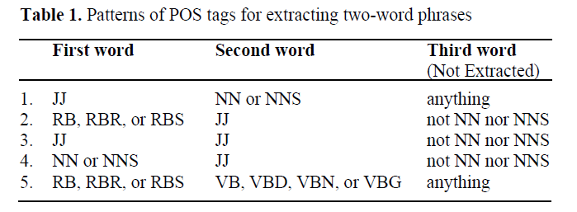
Sentiment Classification
Unsupervised learning (P. Turney)
3 steps algorithm:
extracts phrases containing adjectives or adverbs and a context word to determine orientation
estimates the orientation of the extracted phrases using the pointwise mutual information measure
Notes:
«Opinion words and phrases important are dominant indicators for sentiment classification»
E’ mostrato un algoritmo non supervisionato che fa uso di parole e frasi comuni per esprimere opinioni.
Nella tabella sono listati i pattern usati per estrarre frasi da due parole.
Al numeratore c’è la probabilità di occorrenza di term1 e term2, al denominatore la probabilità di occorrenza se sono statisticamente indipendenti
Il rapporto della formula è un indice del grado di dipendenza statistica
PMI: log of this ratio is the amount of information that we acquire about the presence of one of the words when we observe the other

Slide 23
Sentiment Classification
The opinion orientation of a phrase is computed based on its association with the positive reference word «excellent» and its associations with the negative reference word «poor»
Using the AltaVista «NEAR» operator
computes the average oo of all phrases
the review is classified as recommended if the average oo is positive
Notes:
Operatore NEAR = vincola i risultati ad avere le parole cercate a non più di 10 di distanza

Slide 24
Sentence-level subjectivity
Task
given a sentence s, determine whether s is a subjective sentence or an objective (subjectivity classification) and if s is subjective, determine its orientation (sentiment-level classification)
Naive Bayes
To save manual labeling effort
Bootstrapping approach
2 classifiers (HP-Subj, HP-Obj)
sentences are tagged «subjective» if HP-Subj find two or more clues
sencentes are tagged «objective» if HP-Obj can’t find any subjective clues
extracted sentences are added to the training set to learn patterns in the next iteration
Notes:
1) Filtra frasi che non contengono opinioni
2) Sappiamo di quali oggetti (e le relative feature) di cui si parla nelle frasi, serve per il task più grande
Metodi di apprendimento supervisionato tradizionali (come il Naive Bayes) sono applicabili
Per evitare di taggare a mano le singole frasi d’esempio, si usano metodi di bootstrapping
si usano due classificatori molto precisi (ma poco generalizzanti), usano liste di termini lessicali (unigrammi, n-grammi)

Slide 25
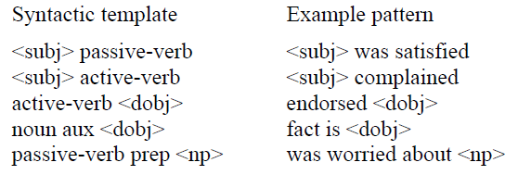
Sentence-level subjectivity
examples of syntactic templates
Assumption
single opinion, single opinion holder h
Yu and Hazivassilogou perform subjective identification
Sentence similarity
Naive Bayes
Multiple Naive Bayes

Slide 26
Sentence-level subjectivity
For sentiment classification of each identified subjective sentence
similar to the Turney method but with many more seed words
Log-likelihood ratio score function
Notes:
Compound sentences?

Slide 27
Opinion lexicon generation
Opinion Lexicon
group of words that rapresent an opinion
base / comparative types
comparative type lexicon used to express comparative and superlative opinions
better, worse, best, worst, etc.
used in sentiment analysis of comparative sentences
To compile opinion word list
manual
dictionary-based
corpus-based and sentiment consistency
Notes:
Opinion words are used in sentiment classification tasks, but How they are generated?
Base/comparative type (words of comparative type cannot be used in the same way as the base one due to ...)
In this section we focus on opinion words of base type
L’approccio manuale non è usato da solo, ma per fare «fine-tuning» dei risultati dei metodi automatizzati (che sono soliti commettere alcuni errori)

Slide 28
Opinion lexicon generation
Dictionary based approach
use a web dictionary (e.g. WordNet) searching for synonyms and antinonyms of seed opinion words from a small dictionary
add these words and perform a new iteration stopping when no words are added
manual fine tuning of the results
unable to find opinion words with domain specific orientations
Corpus based approach
from a list of seed opinion adjective words, using co-occurence or syntactic patterns finds other words in a corpus
AND rule:
«This cas is beautiful and spacious»
OR, BUT, EITHER-OR, etc.
hard to prepare e huge corpus that cover all English words
Notes:
Remark 1: coherency, intra/inter-sentential consistency. Inter sent. si applica a frasi vicine: lo stesso orientamento è usato in frasi consecutive
Remark 2: double propagation, processo di bootstrapping ottenuto propagando sia feature che opinion word (perchè c’è una qualche sorta di legame tra i due concetti); queste relazioni sono modellate tramite «Dependency grammar».
Opinon context: <object_feature, opinion_word> per modellare diversi orientamenti di parole in differenti contesti dello stesso dominio.
Pag 16 ulteriori remark

Slide 29
Feature-based Sentiment Analysis

Slide 30
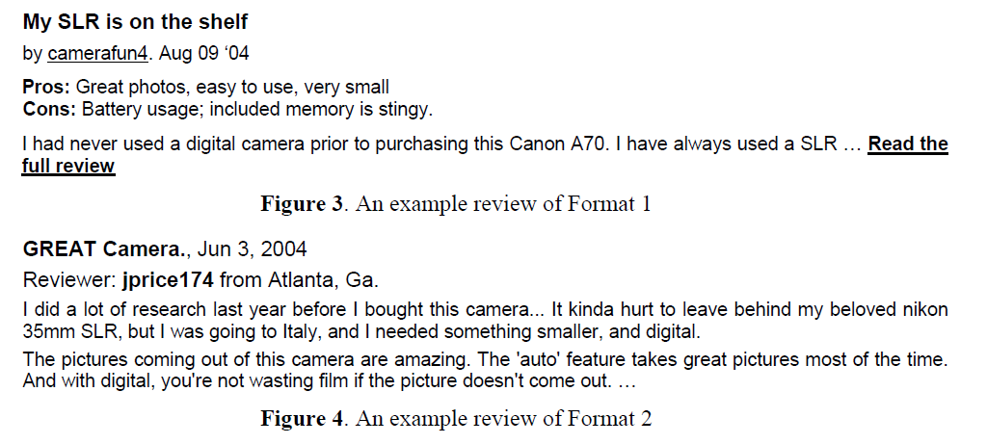
Featured-based Sentiment Analysis
Discover all <o_{j}, f_{jk}, oo_{ijkl}, h_{i}, t_{l}> and identify W_{jk}, I_{jk} for each f_{jk}
Find object features & identify opinion orientation
Feature extraction
mainly carried out in online product reviews. Two formats assumed:
Pro/cons plus detailed review
Free format text
Notes:
Non è detto che un’opinione positiva (o negativa) su un oggetto implichi un giudizio positivo (o negativo) su tutte le sue feature.
A volte è necessario avere conoscenza più dettagliata. E’ questo lo scopo del «feature-based sentiment analysis» che sia avvale del modello più dettagliato precedentemente esposto.
Siccome è condotto sulle review online si possono fare assunzioni sui possibili formati testuali
Remark 1: altri problemi coreference resolution, named entity recognition (NER)

Slide 31
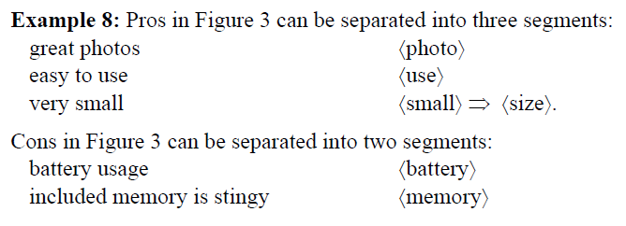
Featured-based Sentiment Analysis
Feature extraction from Pro/Cons of Format 1
Supervised pattern learning approach
Conditional Random Fields (CRF)
Sequential Rule based method
using label sequential rules (LSR)
A LSR is of the following form
X Y, where Y is a sequence and X is a segment produced from Y by replacing some of its items with wildcards, denoted with ‘*’
Notes:
Supervised pattern learning approach
Possono essere usati molti metodi per estrarre feature, tra cui CRF, SR
Remark: una wildcard può matchare qualsiasi item.

Slide 32
Featured-based Sentiment Analysis
Learning process
each segment is first converted in a sequence
A sequence element is the word itself and the POS tag
object features are manually labeled and replaced by the label $feature
explicit/implicit feature indicator are handled
patterns are matched with each sentence segment
words that match $feature in a pattern are extracted
Notes:
Remark 1: an object feature can be expressed with a noun, adjective, verb or adverb.
Thus, they represent both explicit features and implicit feature indicators.
The labels and their POS tags used in mining LSRs are: {$feature, NN}, {$feature, JJ}, {$feature, VB} and {$feature, RB}, where $feature denotes a feature to be extracted, and NN stands for noun, VB for verb, JJ for adjective, and RB for adverb.
Note that to simplify the presentation, we use NN and VB to represent all forms of nouns and verbs respectively.
Remark 2: nel pattern matching solo il lato destro è usato; in fase di generazione della regola sono considerati entrambi per calcolare la confidenza

Slide 33
Featured-based Sentiment Analysis
Feature extraction from reviews of Format 1I
apply previous techniques
Not efficient, due to high noise
Unsupervided method
Find frequently repeated nouns and nouns phrases
identified with a POS tagger
their occurence frequencies are counted, only the frequent ones are kept
with good probability those are features
Find infrequent features by using opinion words
ghfghgf
Notes:
Unsupervised methods for explicit features extraction
Le feature identificate al passo 1) sono quelle «importanti»
Le feature identificate al passo 2) sono quelle ...

Slide 34
Featured-based Sentiment Analysis
After the extraction of object features, two additional problems need to be solved, both domain dependent tasks
Identifying and grouping synonyms
WordNet and other thesaurus dictionaries method are far from sufficient
Similarity metrics proposed based on
taxonomy of features
string similarity, synonims and other distances measured using WordNet
Mapping to implicit features
Adjectives and adverbs, feature indicators, need to be mapped to their corresponding implicit features

Slide 35
Opinion Orientation Identification
Identify the orientation of opinions expressed on an object feature in a sentence
Lexicon-based approach
Identifying opinion words and phrases
Each positive word is assigned the opinion score of +1
Each negative word is assigned the opinion score of -1
Each context dependent word is assigned the opinon score of 0
Handling negations
Revise the opinion score obtained at step 1 based on some negation handling rule
But-clauses
The opinion orientation before but and after but are opposite to each other
Aggregating opinions
Applies an opinion aggregation function to the resulting opinion scores to determine the final orientation of the opinion on each object feature in the sentence
Shortcoming:
opinion words and phrases do not cover all expressions that convey or imply opinions
Notes:
The lexicon-based approach basically uses opinion words and phrases in a sentence to determine the
orientation of the opinion. Apart from the opinion lexicon, negations and but-clauses in a sentence are
also crucial and need to be handled. The approach works as follows [36, 19]:
Remark 1:
Remark 2: not every “not” means negation, e.g., “not only … but also”. Such nonnegation phrases containing negation words need to be considered separately.
Remark 3: not every but means contrary, e.g., “not only … but also”. Such non-but phrases containing “but” also need to be considered separately.
Remark 4: where opj is an opinion word in s, d(opj, fi) is the distance between feature fi and opinion word opj in s.
opj.so is the orientation or the opinion score of opi. The multiplicative inverse in the formula is used to
give low weights to opinion words that are far away from feature fi. If the final score is positive, then
the opinion on feature fi in s is positive. If the final score is negative, then the opinion on the feature is
negative. It is neutral otherwise.
Remark (shortcoming) “There are in fact many others. Below, we present basic rules of opinions.”

Slide 36
Opinion Orientation Identification
Basic rules of opinions

Slide 37
Sentiment Analysis of Comparative Sentences

Slide 38
Sentiment Analysis of Comparative Sentences
Def: todo
Regular comparatives
type1, type 2
Irregular comparative
Increasing/Decreasing
Types of comparative relations
Gradable
Non equal
Equative
Superlative
Non gradable
Mining objective
Comparison mining
Comparative opinion
(o1,o2, f, po, h, t)

Slide 39
Sentiment Analysis of Comparative Sentences
To identify comparative sentences
Alcune eccezioni
Keywords alone
High recall
Ci sono spesso pattern frequenti
Usato CSR
La classificazione nei 3 tipi avviene tramite le sole keyword e usando una SVM

Slide 40
Sentiment Analysis of Comparative Sentences
To extract objects and features
CRF, Hidden Markov Models (HMM)
LSR + CRF
To identify preferred objects
Comparative opinion
Objects ranking
2 categorie per comparison
Comparative opinion words (type1, type2)
Context-dependent comparative opinion words
Type1: it is necessary to join the meanings of the comparative with the domain to know if the expression’s orientation
Type 2: external information is used -> pro/cons

Slide 41
Opinion Search and Retrieval

Slide 42
Opinion Search and Retrieval
Retrieve documents and sentences that are relevant to the query and identifying and ranking the results
Examples:
“find public opinions on a particular object or a feature of the object”
“find opinions of a person or organization on a particular object or a feature of the object”
Bisogna modificare il criterio di ranking per query di tipo A
2 obiettivi:
Rank higher document with more informations
Preserve natural distribution
2 ranking
Notes:
2 task il secondo dei quali è più caratterizzante dell’opinion mining
«A volte è importante sapere le diverse percentuali di opinioni -> 2 rankings»

Slide 43
Opinion Search and Retrieval
Feature-based summary
TREC
2 components (Retrieval, opinion classification component)
SVM, sentence partitioning
Opinionated if at least one phrase opinionated
Un secondo classificatore trova l’orientamento

Slide 44
Opinion Spam and Utility of Opinions

Slide 45
Opinion Spam and Utility of Opinions
Email / Web spam
Contestualizzare opinion spam
Def. Opinion spam
Opinion spam types:
Untruthful opinions
Opinions on brands only
Non opinions
Type 2, 3 si usano metodi tradizionali, il problema è trovare un insieme di dati di training. La difficoltà di sposta nel trovare un insieme adeguato di features
Review/Reviewer/Product centric features
Logistic regression, fairly easy
Notes:
«Untruthful opinions» sono falsi positivi/negativi, detti anche «Hype spam/Defaming spam»
«Opinion on...» non commentano su un particolare oggetto ma speculano sul marchio
«Non opinions» sono advertisements, domande/risposte, testo casuale

Slide 46
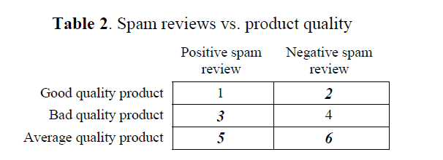
Opinion Spam and Utility of Opinions
Derivo condizione necessaria
Notes:
1-4 conflitto di interessi
Training data -> duplicates
Commenti sui diversi tipi di duplicati
Analisi dei risultati

Slide 47
Utility of Reviews
Regression problem da un modello imparato
Training / test set da un sito di review online
Used features:
TODO
Subjectivity classification
Binary classification
Feedback spam
Notes:
Remarks: reviews utility vs review spam detection

Slide 48
References (1)
Handbook of Natural Language Processing, chapter 26, Bing Liu, University of Illinois at Chicago
P. Turney, “Thumbs up or thumbs down? Semantic orientation applied to unsupervised classification of reviews,” Proceedings of the Association for Computational Linguistics (ACL), pp. 417–424, 2002.
B. Pang and L. Lee, “Opinion mining and sentiment analysis.” Foundations and Trends in Information Retrieval 2(1-2), pp. 1–135, 2008.
B. Liu, Web Data Mining: Exploring Hyperlinks, Contents, and Usage Data. Springer, 2006.
M. Hu and B. Liu, “Mining and summarizing customer reviews,” Proceedings of the ACM SIGKDD Conference on Knowledge Discovery and Data Mining (KDD), pp. 168–177, 2004.
B. Liu, M. Hu, and J. Cheng, “Opinion observer: Analyzing and comparing opinions on the web,” Proceedings of WWW, 2005.
T. Wilson, J. Wiebe, and R. Hwa, “Just how mad are you? Finding strong and weak opinion clauses,” Proceedings of AAAI, pp. 761–769, 2004.
B. Pang, L. Lee, and S. Vaithyanathan, “Thumbs up? Sentiment classification using machine learning techniques,” Proceedings of the Conference on Empirical Methods in Natural Language Processing (EMNLP), pp. 79–86, 2002.
B. Pang and L. Lee, “Seeing stars: Exploiting class relationships for sentiment categorization with respect to rating scales,” Proceedings of the Association for Computational Linguistics (ACL), pp. 115–124, 2005.
R. M. Tong, “An operational system for detecting and tracking opinions in on-line discussion.” Proceedings of the Workshop on Operational Text Classification (OTC), 2001.

Slide 49
References (2)
A. Aue and M. Gamon, “Customizing sentiment classifiers to new domains: A case study,” Proceedings of Recent Advances in Natural Language Processing (RANLP), 2005.
E. Breck, Y. Choi, and C. Cardie, “Identifying expressions of opinion in context,” Proceedings of the International Joint Conference on Artificial Intelligence (IJCAI), 2007.
V. Hatzivassiloglou and K. McKeown, “Predicting the semantic orientation of adjectives,” Proceedings of the Joint ACL/EACL Conference, pp. 174–181, 1997.
V. Hatzivassiloglou and J. Wiebe, “Effects of adjective orientation and gradability on sentence subjectivity,” Proceedings of the International Conference on Computational Linguistics (COLING), 2000.
J. Wiebe, R. F. Bruce, and T. P. O’Hara. “Development and use of a gold standard data set for subjectivity classifications.” Proceedings of the Association for Computational Linguistics (ACL), pp. 246–253, 1999.
E. Riloff and J. Wiebe, “Learning extraction patterns for subjective expressions,” Proceedings of the Conference on Empirical Methods in Natural Language Processing (EMNLP), 2003.
E. Riloff, J. Wiebe, and T. Wilson, “Learning subjective nouns using extraction pattern bootstrapping,” Proceedings of the Conference on Natural Language Learning (CoNLL), pp. 25–32, 2003.
H. Yu and V. Hatzivassiloglou, “Towards answering opinion questions: Separating facts from opinions and identifying the polarity of opinion sentences,” Proceedings of the Conference on Empirical Methods in Natural Language Processing (EMNLP), 2003.

Slide 50
References (3)

Slide 51
Thank You For Your Attention!
☺

