Slide 1
Chapter 5
Association Analysis: Basic Concepts
Introduction to Data Mining, 2nd Edition
by
Tan, Steinbach, Karpatne, Kumar

Slide 2
Association Rule Mining
Given a set of transactions, find rules that will predict the occurrence of an item based on the occurrences of other items in the transaction
Market-Basket transactions
Example of Association Rules
{Diaper} → {Beer},
{Milk, Bread} → {Eggs,Coke},
{Beer, Bread} → {Milk},
Implication means co-occurrence, not causality!
  Find groups of items which are frequently purchased together

Slide 3
Definition: Frequent Itemset
Itemset
  A collection of one or more items
    Example: {Milk, Bread, Diaper}
  k-itemset
    An itemset that contains k items
Support count (σ)
  Frequency of occurrence of an itemset
  E.g. σ({Milk, Bread,Diaper}) = 2
Support
  Fraction of transactions that contain an itemset
  E.g. s({Milk, Bread, Diaper}) = 2/5
Frequent Itemset
  An itemset whose support is greater than or equal to a minsup threshold

Slide 4
Definition: Association Rule
Association Rule
  An implication expression of the form X → Y, where X and Y are itemsets
  Example:
  {Milk, Diaper} → {Beer}
Rule Evaluation Metrics
  Support (s)
    Fraction of transactions that contain both X and Y
  Confidence (c)
    Measures how often items in Y
    appear in transactions that
    contain X
Example:

Slide 5
Association Rule Mining Task
Given a set of transactions T, the goal of association rule mining is to find all rules having
  support ≥ minsup threshold
  confidence ≥ minconf threshold
Brute-force approach:
  List all possible association rules
  Compute the support and confidence for each rule
  Prune rules that fail the minsup and minconf thresholds
  ⇒ Computationally prohibitive!

Slide 6
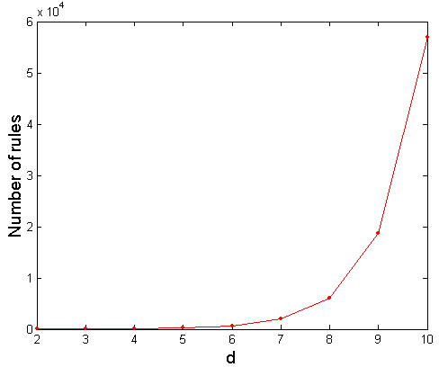
Computational Complexity
Given d unique items:
  Total number of itemsets = 2^{d}
  Total number of possible association rules:
If d=6, R = 602 rules

Slide 7
Mining Association Rules
Example of Rules:
{Milk,Diaper} → {Beer} (s=0.4, c=0.67)
{Milk,Beer} → {Diaper} (s=0.4, c=1.0)
{Diaper,Beer} → {Milk} (s=0.4, c=0.67)
{Beer} → {Milk,Diaper} (s=0.4, c=0.67)
{Diaper} → {Milk,Beer} (s=0.4, c=0.5)
{Milk} → {Diaper,Beer} (s=0.4, c=0.5)
Observations:
All the above rules are binary partitions of the same itemset:
{Milk, Diaper, Beer}
Rules originating from the same itemset have identical support but can have different confidence
Thus, we may decouple the support and confidence requirements

Slide 8
Mining Association Rules
Two-step approach:
  Frequent Itemset Generation
    Generate all itemsets whose support ≥ minsup
  Rule Generation
    Generate high confidence rules from each frequent itemset, where each rule is a binary partitioning of a frequent itemset
Frequent itemset generation is still computationally expensive

Slide 9
Basic Apriori Algorithm
Problem Decomposition
Find the frequent itemsets: the sets of items that satisfy the support constraint
  A subset of a frequent itemset is also a frequent itemset, i.e., if {A,B} is a frequent itemset, both {A} and {B} should be a frequent itemset
  Iteratively find frequent itemsets with cardinality from 1 to k (k-itemset)
Use the frequent itemsets to generate association rules.

Slide 10
Frequent Itemset Generation
Given d items, there are 2^{d} possible candidate itemsets

Slide 11
Frequent Itemset Generation
Brute-force approach:
  Each itemset in the lattice is a candidate frequent itemset
  Count the support of each candidate by scanning the database
  Match each transaction against every candidate
  Complexity ~ O(NMw) => Expensive since M = 2^{d} !!!

Slide 12
Frequent Itemset Generation Strategies
Reduce the number of candidates (M)
  Complete search: M=2^{d}
  Use pruning techniques to reduce M
Reduce the number of transactions (N)
  Reduce size of N as the size of itemset increases
Reduce the number of comparisons (NM)
  Use efficient data structures to store the candidates or transactions
  No need to match every candidate against every transaction

Slide 13
Reducing Number of Candidates
Apriori principle:
  If an itemset is frequent, then all of its subsets must also be frequent
Apriori principle holds due to the following property of the support measure:
  Support of an itemset never exceeds the support of its subsets
  This is known as the anti-monotone property of support

Slide 14
Illustrating Apriori Principle
Found to be Infrequent
Pruned supersets

Slide 15
Illustrating Apriori Principle
Items (1-itemsets)
Minimum Support = 3

Slide 16
Illustrating Apriori Principle
Items (1-itemsets)
Minimum Support = 3

Slide 17
Illustrating Apriori Principle
Items (1-itemsets)
Pairs (2-itemsets)
(No need to generate
candidates involving Coke
or Eggs)
Minimum Support = 3

Slide 18
Illustrating Apriori Principle
Items (1-itemsets)
Pairs (2-itemsets)
(No need to generate
candidates involving Coke
or Eggs)
Minimum Support = 3

Slide 19
Illustrating Apriori Principle
Items (1-itemsets)
Pairs (2-itemsets)
(No need to generate
candidates involving Coke
or Eggs)
Minimum Support = 3
Triplets (3-itemsets)

Slide 20
Illustrating Apriori Principle
Items (1-itemsets)
Pairs (2-itemsets)
(No need to generate
candidates involving Coke
or Eggs)
Minimum Support = 3
Triplets (3-itemsets)

Slide 21
Illustrating Apriori Principle
Items (1-itemsets)
Pairs (2-itemsets)
(No need to generate
candidates involving Coke
or Eggs)
Minimum Support = 3
Triplets (3-itemsets)

Slide 22
Apriori Algorithm
  F_{k}: frequent k-itemsets
  L_{k}: candidate k-itemsets
Algorithm
  Let k=1
  Generate F₁ = {frequent 1-itemsets}
  Repeat until F_{k} is empty
    Candidate Generation: Generate L_{k+1} from F_{k}
    Candidate Pruning: Prune candidate itemsets in L_{k+1} containing subsets of length k that are infrequent
    Support Counting: Count the support of each candidate in L_{k+1} by scanning the DB
    Candidate Elimination: Eliminate candidates in L_{k+1} that are infrequent, leaving only those that are frequent => F_{k+1}

Slide 23
Candidate Generation: F_{k-1} x F_{k-1} Method
Merge two frequent (k-1)-itemsets if their first (k-2) items are identical
F₃ = {ABC,ABD,ABE,ACD,BCD,BDE,CDE}
  Merge(ABC, ABD) = ABCD
  Merge(ABC, ABE) = ABCE
  Merge(ABD, ABE) = ABDE
  Do not merge(ABD,ACD) because they share only prefix of length 1 instead of length 2

Slide 24
Candidate Pruning
Let F₃ = {ABC,ABD,ABE,ACD,BCD,BDE,CDE} be the set of frequent 3-itemsets
L₄ = {ABCD,ABCE,ABDE} is the set of candidate 4-itemsets generated (from previous slide)
Candidate pruning
  Prune ABCE because ACE and BCE are infrequent
  Prune ABDE because ADE is infrequent
After candidate pruning: L₄ = {ABCD}

Slide 25
Illustrating Apriori Principle
Items (1-itemsets)
Pairs (2-itemsets)
(No need to generate
candidates involving Coke
or Eggs)
Minimum Support = 3
Triplets (3-itemsets)
Use of F_{k-1}xF_{k-1} method for candidate generation results in
only one 3-itemset. This is eliminated after the support counting step.

Slide 26
Alternate F_{k-1} x F_{k-1} Method
Merge two frequent (k-1)-itemsets if the last (k-2) items of the first one is identical to the first (k-2) items of the second.
F₃ = {ABC,ABD,ABE,ACD,BCD,BDE,CDE}
  Merge(ABC, BCD) = ABCD
  Merge(ABD, BDE) = ABDE
  Merge(ACD, CDE) = ACDE
  Merge(BCD, CDE) = BCDE

Slide 27
Candidate Pruning for Alternate F_{k-1} x F_{k-1} Method
Let F₃ = {ABC,ABD,ABE,ACD,BCD,BDE,CDE} be the set of frequent 3-itemsets
L₄ = {ABCD,ABDE,ACDE,BCDE} is the set of candidate 4-itemsets generated (from previous slide)
Candidate pruning
  Prune ABDE because ADE is infrequent
  Prune ACDE because ACE and ADE are infrequent
  Prune BCDE because BCE
After candidate pruning: L₄ = {ABCD}

Slide 28
Support Counting of Candidate Itemsets
Scan the database of transactions to determine the support of each candidate itemset
  Must match every candidate itemset against every transaction, which is an expensive operation

Slide 29
Support Counting of Candidate Itemsets
To reduce number of comparisons, store the candidate itemsets in a hash structure
  Instead of matching each transaction against every candidate, match it against candidates contained in the hashed buckets

Slide 30
Rule Generation
Given a frequent itemset L, find all non-empty subsets f ⊂ L such that f → L – f satisfies the minimum confidence requirement
  If {A,B,C,D} is a frequent itemset, candidate rules:
    ABC →D, ABD →C, ACD →B, BCD →A,
    A →BCD, B →ACD, C →ABD, D →ABC
    AB →CD, AC → BD, AD → BC, BC →AD,
    BD →AC, CD →AB,
If |L| = k, then there are 2^{k} – 2 candidate association rules (ignoring L → ∅ and ∅ → L)

Slide 31
Rule Generation
In general, confidence does not have an anti-monotone property
  c(ABC →D) can be larger or smaller than c(AB →D)
But confidence of rules generated from the same itemset has an anti-monotone property
  E.g., Suppose {A,B,C,D} is a frequent 4-itemset:
  c(ABC → D) ≥ c(AB → CD) ≥ c(A → BCD)
  Confidence is anti-monotone w.r.t. number of items on the RHS of the rule

Slide 32
Rule Generation for Apriori Algorithm
Lattice of rules
Low Confidence Rule
Pruned Rules

Slide 33
Factors Affecting Complexity of Apriori
Choice of minimum support threshold
  lowering support threshold results in more frequent itemsets
  this may increase number of candidates and max length of frequent itemsets
Dimensionality (number of items) of the data set
  More space is needed to store support count of itemsets
  if number of frequent itemsets also increases, both computation and I/O costs may also increase
Size of database
  run time of algorithm increases with number of transactions
Average transaction width
  transaction width increases the max length of frequent itemsets
  number of subsets in a transaction increases with its width, increasing computation time for support counting

Slide 34
Maximal Frequent Itemset
An itemset is maximal frequent if it is frequent and none of its immediate supersets is frequent
Maximal Itemsets
Infrequent Itemsets
Border

Slide 35
An illustrative example
Items
 | A | B | C | D | E | F | G | H | I | J
1
2
3
4
5
6
7
8
9
10
Support threshold (by count) : 5
Frequent itemsets: ?
Maximal itemsets: ?
Transactions

Slide 36
An illustrative example
Items
 | A | B | C | D | E | F | G | H | I | J
1
2
3
4
5
6
7
8
9
10
Support threshold (by count) : 5
Frequent itemsets: {F}
Maximal itemsets: {F}
Support threshold (by count): 4
Frequent itemsets: ?
Maximal itemsets: ?
Transactions

Slide 37
An illustrative example
Items
 | A | B | C | D | E | F | G | H | I | J
1
2
3
4
5
6
7
8
9
10
Support threshold (by count) : 5
Frequent itemsets: {F}
Maximal itemsets: {F}
Support threshold (by count): 4
Frequent itemsets: {E}, {F}, {E,F}, {J}
Maximal itemsets: {E,F}, {J}
Transactions

Slide 38
Another illustrative example
Items
 | A | B | C | D | E | F | G | H | I | J
1
2
3
4
5
6
7
8
9
10
Support threshold (by count) : 5
Maximal itemsets: {A}, {B}, {C}
Support threshold (by count): 4
Maximal itemsets: {A,B}, {A,C},{B,C}
Support threshold (by count): 3
Maximal itemsets: {A,B,C}
Transactions

Slide 39
Closed Itemset
An itemset X is closed if none of its immediate supersets has the same support as the itemset X.
X is not closed if at least one of its immediate supersets has support count as X.

Slide 40
Maximal vs Closed Itemsets
Transaction Ids
Not supported by any transactions

Slide 41
Maximal Frequent vs Closed Frequent Itemsets
Minimum support = 2
Closed but not maximal
Closed and maximal
# Closed = 9
# Maximal = 4

Slide 42
Example 1
Items
 | A | B | C | D | E | F | G | H | I | J
1
2
3
4
5
6
7
8
9
10
Itemsets | Support (counts) | Closed itemsets
{C} | 3
{D} | 2
{C,D} | 2
Transactions

Slide 43
Example 1
Items
 | A | B | C | D | E | F | G | H | I | J
1
2
3
4
5
6
7
8
9
10
Itemsets | Support (counts) | Closed itemsets
{C} | 3 | ✓
{D} | 2
{C,D} | 2 | ✓
Transactions

Slide 44
Example 2
Items
 | A | B | C | D | E | F | G | H | I | J
1
2
3
4
5
6
7
8
9
10
Itemsets | Support (counts) | Closed itemsets
{C} | 3
{D} | 2
{E} | 2
{C,D} | 2
{C,E} | 2
{D,E} | 2
{C,D,E} | 2
Transactions

Slide 45
Example 2
Items
 | A | B | C | D | E | F | G | H | I | J
1
2
3
4
5
6
7
8
9
10
Itemsets | Support (counts) | Closed itemsets
{C} | 3 | ✓
{D} | 2
{E} | 2
{C,D} | 2
{C,E} | 2
{D,E} | 2
{C,D,E} | 2 | ✓
Transactions

Slide 46
Maximal vs Closed Itemsets

Slide 47
Pattern Evaluation
Association rule algorithms can produce large number of rules
Interestingness measures can be used to prune/rank the patterns
  In the original formulation, support & confidence are the only measures used

Slide 48
Computing Interestingness Measure
Given X → Y or {X,Y}, information needed to compute interestingness can be obtained from a contingency table
Contingency table
 | Y | Y
X | f₁₁ | f₁₀ | f₁₊
X | f₀₁ | f₀₀ | f_{o+}
 | f₊₁ | f₊₀ | N
f₁₁: support of X and Y
f₁₀: support of X and Y
f₀₁: support of X and Y
f₀₀: support of X and Y
Used to define various measures
support, confidence, Gini,
entropy, etc.

Slide 49
Drawback of Confidence
Customers | Tea | Coffee | …
C1 | 0 | 1 | …
C2 | 1 | 0 | …
C3 | 1 | 1 | …
C4 | 1 | 0 | …
…
Association Rule: Tea → Coffee
Confidence ≅ P(Coffee|Tea) = 150/200 = 0.75
Confidence > 50%, meaning people who drink tea are more likely to drink coffee than not drink coffee
So rule seems reasonable

Slide 50
Drawback of Confidence
 | Coffee | Coffee
Tea | 150 | 50 | 200
Tea | 650 | 150 | 800
 | 800 | 200 | 1000
Association Rule: Tea → Coffee
Confidence= P(Coffee|Tea) = 150/200 = 0.75
but P(Coffee) = 0.8, which means knowing that a person drinks tea reduces the probability that the person drinks coffee!
Note that P(Coffee|Tea) = 650/800 = 0.8125

Slide 51
Drawback of Confidence
Customers | Tea | Honey | …
C1 | 0 | 1 | …
C2 | 1 | 0 | …
C3 | 1 | 1 | …
C4 | 1 | 0 | …
…
Association Rule: Tea → Honey
Confidence ≅ P(Honey|Tea) = 100/200 = 0.50
Confidence = 50%, which may mean that drinking tea has little influence whether honey is used or not
So rule seems uninteresting
But P(Honey) = 120/1000 = .12 (hence tea drinkers are far more likely to have honey

Slide 52
Measure for Association Rules
So, what kind of rules do we really want?
  Confidence(X → Y) should be sufficiently high
    To ensure that people who buy X will more likely buy Y than not buy Y
  Confidence(X → Y) > support(Y)
    Otherwise, rule will be misleading because having item X actually reduces the chance of having item Y in the same transaction
    Is there any measure that capture this constraint?
      Answer: Yes. There are many of them.

Slide 53
Statistical Relationship between X and Y
The criterion
confidence(X → Y) = support(Y)
is equivalent to:
  P(Y|X) = P(Y)
  P(X,Y) = P(X) × P(Y) (X and Y are independent)
  If P(X,Y) > P(X) × P(Y) : X & Y are positively correlated
  If P(X,Y) < P(X) × P(Y) : X & Y are negatively correlated

Slide 54
Measures that take into account statistical dependence
lift is used for rules while interest is used for itemsets

Slide 55
Example: Lift/Interest
 | Coffee | Coffee
Tea | 150 | 50 | 200
Tea | 650 | 150 | 800
 | 800 | 200 | 1000
Association Rule: Tea → Coffee
Confidence= P(Coffee|Tea) = 0.75
but P(Coffee) = 0.8
Interest = 0.15 / (0.2×0.8) = 0.9375 (< 1, therefore is negatively associated)

Slide 56
There are lots of measures proposed in the literature

Slide 57
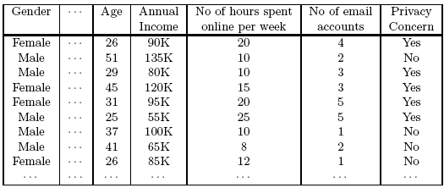
Continuous and Categorical Attributes
How to apply association analysis to non-asymmetric binary variables?
Example of Association Rule:
{Gender=Male, Age ∈ [21,30)} → {No of hours online ≥ 10}

Slide 58
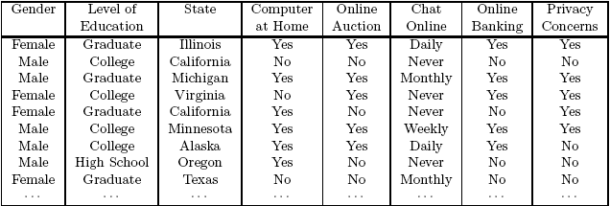
Handling Categorical Attributes
Example: Internet Usage Data
  {Level of Education=Graduate, Online Banking=Yes}
  → {Privacy Concerns = Yes}

Slide 59
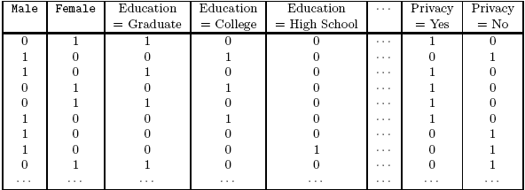
Handling Categorical Attributes
Introduce a new “item” for each distinct attribute-value pair

Slide 60
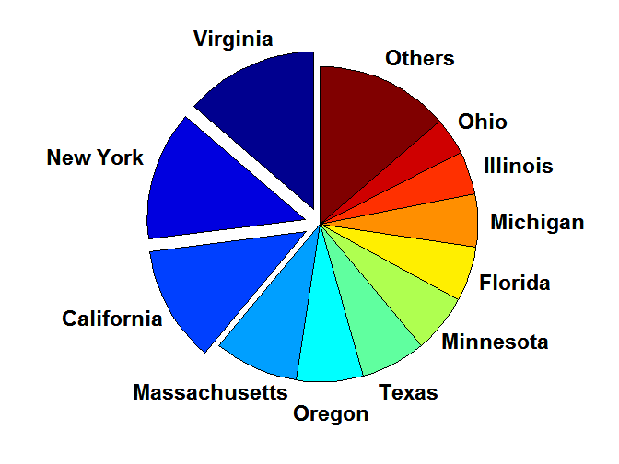
Handling Categorical Attributes
Some attributes can have many possible values
  Many of their attribute values have very low support
    Potential solution: Aggregate the low-support attribute values

Slide 61
Handling Categorical Attributes
Distribution of attribute values can be highly skewed
  Example: 85% of survey participants own a computer at home
    Most records have Computer at home = Yes
    Computation becomes expensive; many frequent itemsets involving the binary item (Computer at home = Yes)
    Potential solution:
      discard the highly frequent items
      Use alternative measures such as h-confidence
Computational Complexity
  Binarizing the data increases the number of items
  But the width of the “transactions” remain the same as the number of original (non-binarized) attributes
  Produce more frequent itemsets but maximum size of frequent itemset is limited to the number of original attributes

Slide 62
Handling Continuous Attributes
Different methods:
  Discretization-based
  Statistics-based
  Non-discretization based
    minApriori
Different kinds of rules can be produced:
  {Age∈[21,30), No of hours online∈[10,20)}
  → {Chat Online =Yes}
  {Age∈[21,30), Chat Online = Yes}
  → No of hours online: μ=14, σ=4

Slide 63
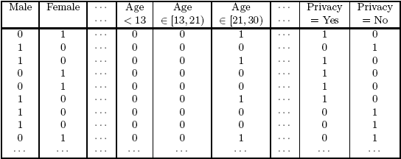
Discretization-based Methods

Slide 64
Discretization-based Methods
Unsupervised:
  Equal-width binning
  Equal-depth binning
  Cluster-based
Supervised discretization
<1 2 3> <4 5 6> <7 8 9>
<1 2 > <3 4 5 6 7 > < 8 9>
Continuous attribute, v
₁
₂
₃
₄
₅
₆
₇
₈
₉
Chat Online = Yes
0
0
20
10
20
0
0
0
0
Chat Online = No
150
100
0
0
0
100
100
150
100
bin₁
bin₂
bin₃

Slide 65

Discretization Issues
Interval width

Slide 66
Discretization Issues
Interval too wide (e.g., Bin size= 30)
  May merge several disparate patterns
    Patterns A and B are merged together
  May lose some of the interesting patterns
    Pattern C may not have enough confidence
Interval too narrow (e.g., Bin size = 2)
  Pattern A is broken up into two smaller patterns
    Can recover the pattern by merging adjacent subpatterns
  Pattern B is broken up into smaller patterns
    Cannot recover the pattern by merging adjacent subpatterns
  Some windows may not meet support threshold

Slide 67
Statistics-based Methods
Example:
  {Income > 100K, Online Banking=Yes} → Age: μ=34
Rule consequent consists of a continuous variable, characterized by their statistics
  mean, median, standard deviation, etc.
Approach:
  Withhold the target attribute from the rest of the data
  Extract frequent itemsets from the rest of the attributes
    Binarized the continuous attributes (except for the target attribute)
  For each frequent itemset, compute the corresponding descriptive statistics of the target attribute
    Frequent itemset becomes a rule by introducing the target variable as rule consequent
  Apply statistical test to determine interestingness of the rule

Slide 68
Statistics-based Methods
Frequent Itemsets:
Association Rules:
{Male, Income > 100K}
{Income < 30K, No hours ∈[10,15)}
{Income > 100K, Online Banking = Yes}
….
{Male, Income > 100K} → Age: μ = 30
{Income < 40K, No hours ∈[10,15)} → Age: μ = 24
{Income > 100K,Online Banking = Yes}
→ Age: μ = 34
….

Slide 69
Concept Hierarchies

Slide 70
Multi-level Association Rules
Why should we incorporate concept hierarchy?
  Rules at lower levels may not have enough support to appear in any frequent itemsets
  Rules at lower levels of the hierarchy are overly specific
    e.g., skim milk → white bread, 2% milk → wheat bread,
    skim milk → wheat bread, etc.
    are indicative of association between milk and bread
  Rules at higher level of hierarchy may be too generic

Slide 71
Multi-level Association Rules
How do support and confidence vary as we traverse the concept hierarchy?
  If X is the parent item for both X1 and X2, then
  σ(X) ≤ σ(X1) + σ(X2)
  If σ(X1 ∪ Y1) ≥ minsup,
  and X is parent of X1, Y is parent of Y1
  then σ(X ∪ Y1) ≥ minsup, σ(X1 ∪ Y) ≥ minsup
  σ(X ∪ Y) ≥ minsup
  If conf(X1 ⇒ Y1) ≥ minconf,
  then conf(X1 ⇒ Y) ≥ minconf
Notes:
S(x) >= S(x1)

Slide 72
Multi-level Association Rules
Approach 1:
  Extend current association rule formulation by augmenting each transaction with higher level items
  Original Transaction: {skim milk, wheat bread}
  Augmented Transaction:
  {skim milk, wheat bread, milk, bread, food}
Issues:
  Items that reside at higher levels have much higher support counts
    if support threshold is low, too many frequent patterns involving items from the higher levels
  Increased dimensionality of the data

Slide 73
Multi-level Association Rules
Approach 2:
  Generate frequent patterns at highest level first
  Then, generate frequent patterns at the next highest level, and so on
Issues:
  I/O requirements will increase dramatically because we need to perform more passes over the data
  May miss some potentially interesting cross-level association patterns

Slide 74
Support Count strategy

Slide 75
Support Counting: An Example
Suppose you have 15 candidate itemsets of length 3:
{1 4 5}, {1 2 4}, {4 5 7}, {1 2 5}, {4 5 8}, {1 5 9}, {1 3 6}, {2 3 4}, {5 6 7}, {3 4 5}, {3 5 6}, {3 5 7}, {6 8 9}, {3 6 7}, {3 6 8}
How many of these itemsets are supported by transaction (1,2,3,5,6)?
Notes:
An alternative approach is to enumerate the itemsets contained in each transaction and use them to update the support counts of their respective candidate itemsets.
The number of ways to specify the first item of a 3-itemset contained in t is illustrated by the Level 1 prefix tree structure
Level 2 represents the number of ways to select the second item
Level 3 represents the complete set of 3-itemsets contained in t.

Slide 76
Support Counting Using a Hash Tree
Suppose you have 15 candidate itemsets of length 3:
{1 4 5}, {1 2 4}, {4 5 7}, {1 2 5}, {4 5 8}, {1 5 9}, {1 3 6}, {2 3 4}, {5 6 7}, {3 4 5}, {3 5 6}, {3 5 7}, {6 8 9}, {3 6 7}, {3 6 8}
You need:
Hash function
Max leaf size: max number of itemsets stored in a leaf node (if number of candidate itemsets exceeds max leaf size, split the node)
Hash function
2 3 4
5 6 7
3,6,9
1,4,7
1 4 5
3 4 5
3 5 6
3 5 7
6 8 9
3 6 7
3 6 8
1 3 6
2,5,8
1 2 4
4 5 7
1 2 5
4 5 8
1 5 9
Notes:
candidate itemsets are partitioned into different buckets and stored in a hash tree. During support counting, itemsets contained in each transaction are also hashed into their appropriate buckets. That way, instead of comparing each itemset in the transaction with every candidate itemset, it is matched only against candidate itemsets that belong to the same bucket,

Slide 77
Support Counting Using a Hash Tree
Hash Function
Candidate Hash Tree
1,4,7
3,6,9
2,5,8
2 3 4
5 6 7
1 4 5
1 3 6
3 4 5
3 5 6
3 6 7
Hash on 1, 4 or 7
3 5 7
3 6 8
1 2 4
1 5 9
6 8 9
1 2 5
4 5 7
4 5 8

Slide 78
Support Counting Using a Hash Tree
Hash Function
Candidate Hash Tree
1,4,7
3,6,9
2,5,8
2 3 4
5 6 7
1 4 5
1 3 6
3 4 5
3 5 6
3 6 7
Hash on 2, 5 or 8
3 5 7
3 6 8
1 2 4
1 5 9
6 8 9
1 2 5
4 5 7
4 5 8

Slide 79
Support Counting Using a Hash Tree
Hash Function
Candidate Hash Tree
1,4,7
3,6,9
2,5,8
2 3 4
5 6 7
1 4 5
1 3 6
3 4 5
3 5 6
3 6 7
Hash on 3, 6 or 9
3 5 7
3 6 8
1 2 4
1 5 9
6 8 9
1 2 5
4 5 7
4 5 8

Slide 80
Support Counting Using a Hash Tree
1 2 3 5 6
transaction
Hash Function
1 +
2 3 5 6
2 +
3 5 6
1,4,7
3,6,9
3 +
5 6
2,5,8
2 3 4
5 6 7
1 4 5
1 3 6
3 4 5
3 5 6
3 6 7
3 5 7
3 6 8
1 2 4
1 2 5
1 5 9
6 8 9
4 5 7
4 5 8

Slide 81
Support Counting Using a Hash Tree
1 2 3 5 6
transaction
Hash Function
1 +
2 3 5 6
2 +
3 5 6
1,4,7
3,6,9
1 2 +
3 5 6
3 +
5 6
2,5,8
1 3 +
5 6
2 3 4
1 5 +
6
5 6 7
1 4 5
1 3 6
3 4 5
3 5 6
3 6 7
3 5 7
3 6 8
1 2 4
1 2 5
1 5 9
6 8 9
4 5 7
4 5 8
h(p) = (p-1) mod 3
Notes:
The 3 itemsets can start only with 1, 2 and 3

Slide 82
Support Counting Using a Hash Tree
1 2 3 5 6
transaction
Hash Function
1 +
2 3 5 6
2 +
3 5 6
1,4,7
3,6,9
1 2 +
3 5 6
3 +
5 6
2,5,8
1 3 +
5 6
2 3 4
1 5 +
6
5 6 7
1 4 5
1 3 6
3 4 5
3 5 6
3 6 7
3 5 7
3 6 8
1 2 4
1 2 5
1 5 9
6 8 9
4 5 7
4 5 8
Match transaction against 11 out of 15 candidates
Notes:
If a candidate is a subset of the transaction, its support count is incremented.

