Slide 1

Neural Networks

Slide 2
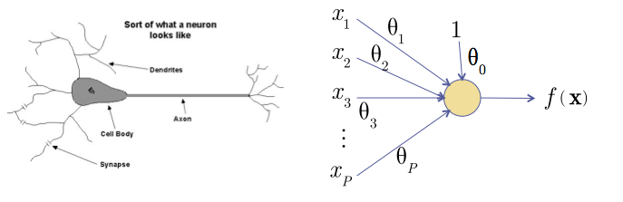
The Neuron Metaphor
Neurons
  accept information from multiple inputs,
  transmit information to other neurons.
Multiply inputs by weights along edges
Apply some function to the set of inputs at each node
Notes:
The study of ANN was inspired by attempts to simulate biological neural systems.
Neurons are linked through axons that tarnsmits nerve inpulses when stimulated.
A neuron is connected to the axons of other neurons via dendrites which are extnesions for the cell body of neurons.
The contact point between a dendrite and an axon is a synapse.
Human barin learns by changing the strength of the synaptic connection between neurons upon repeated stimulation by the same impulse.

Slide 3
Artificial Neural Networks (ANN)
Output Y is 1 if at least two of the three inputs are equal to 1.

Slide 4
Artificial Neural Networks (ANN)
(Bias)
Notes:
The model is an assembly of inter-connected nodes and weighted links
Output node sums up each of its input value according to the weights of its links
Compare output node against some threshold t or bias b

Slide 5
Artificial Neural Networks (ANN)
Model is an assembly of inter-connected nodes and weighted links
Output node sums up each of its input value according to the weights of its links
Compare output node against some threshold t (also named bias b)

Slide 6
Characterizing the Artificial Neuron
Input/Output signal may be:
  Real value
  Unipolar {0, 1}
  Bipolar [-1, +1]
Weight (w or sigma): θ_{ij} – strength of connection from unit j to unit i
Learning amounts to adjusting the weights θ_{ij} by means of an optimization algorithm aiming to minimize a cost function, i.e., as in biological systems training a perceptron model amounts to adapting the weights of the links until they fit the input output relationships of the underlying data.

Slide 7
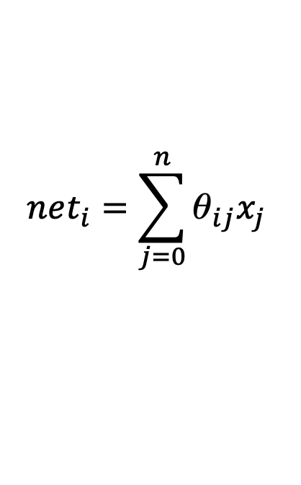
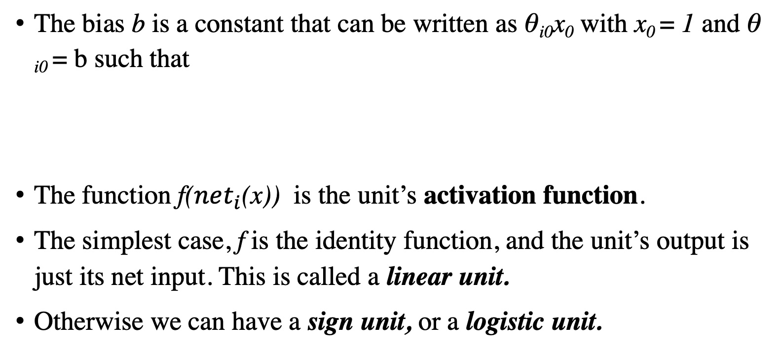
Characterizing the Artificial Neuron
The bias b is a constant that can be written as θ_{i0}x₀ with x₀ = 1 and θ _{i0} = b such that
The function f($net_{i}$(x)) is the unit’s activation function.
The simplest case, f is the identity function, and the unit’s output is just its net input. This is called a linear unit.
Otherwise we can have a sign unit, or a logistic unit.
$$net_{i}=\sum_{j=0}^{n}{{\text{θ}}_{ij}x_{j}}$$

Slide 8
The Perceptron Classifier

Slide 9
Perceptron
Single layer network
  Contains only input and output nodes
Activation function: f = sign(w•x)
Applying model is straightforward
  X₁ = 1, X₂ = 0, X₃ =1 => y = sign(0.2) = 1

Slide 10
Learning Iterative Procedure
During the training phase the weight parameters are adjusted until the outputs of the perceptron become consistent with the true outputs of the training examples.
Initialize the weights (w₀, w₁, …, w_{m})
Repeat
  For each training example (x_{i}, y_{i})
    Compute f(w^{(k)}, x_{i})
    Update the weights:
Until stopping condition is met
Iteration index
Learning rate
Notes:
The new weight is a combination of the old weight and a term proportional to the prediction error. If the prediction is correct the weight remains unchanged.

Slide 11
Perceptron Learning Rule
Weight update formula:
Intuition:
  Update weight based on error:
  If y=f(x,w), e=0: no update needed
  If y>f(x,w), e=2: weight must be increased so that f(x,w) will increase
  If y<f(x,w), e=-2: weight must be decreased so that f(x,w) will decrease

Slide 12
The Learning Rate
Is a parameter with value between 0 and 1 used to control the amount of adjustment made in each iteration.
If is close to 0 the new weight is mostly influenced by the value of the old weight.
If it is close to 1, then the new weight is mostly influenced by the current adjustment.
The learning rate can be adaptive: initially moderately large and the gradually decreases in subsequent iterations.

Slide 13
Nonlinearly Separable Data
Since f(w,x) is a linear combination of input variables, decision boundary is linear.
For nonlinearly separable problems, the perceptron fails because no linear hyperplane can separate the data perfectly.
An example of nonlinearly separable data is the XOR function.
XOR Data

Slide 14
Multilayer Neural Network

Slide 15
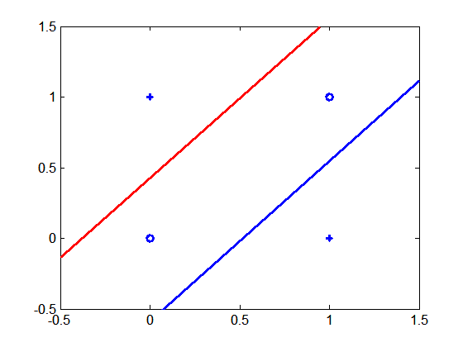
Multilayer Neural Network
Hidden Layers: intermediary layers between input and output layers.
Different type of activation functions (sigmoid, linear, hyperbolic tangent, etc.).
Multi-layer neural network can solve any type of classification task involving nonlinear decision surfaces.
Perceptron is single layer.
We can think to each hidden node as a perceptron that tries to construct one hyperplane, while the output node combines the results to return the decision boundary.
XOR Data

Slide 16
General Structure of ANN
The neurons perform a linear transformation on this input using the weights and biases.
An activation function is applied to it
The output moves to the next hidden layer
Training ANN means learning the weights of the neurons

Slide 17
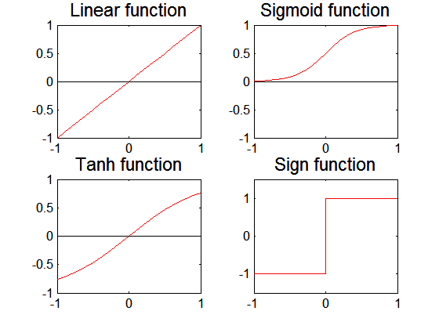
Artificial Neural Networks (ANN)
Various types of neural network topology
  single-layered network (perceptron) versus
  multi-layered network
  Feed-forward versus recurrent network
Various types of
activation functions (f)

Slide 18
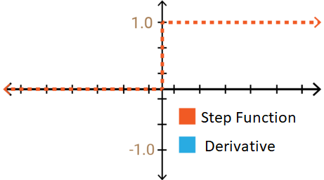
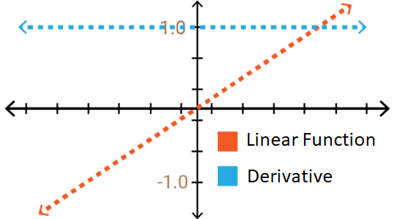
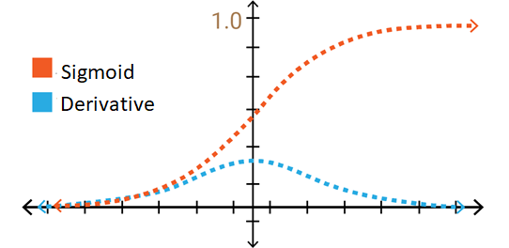
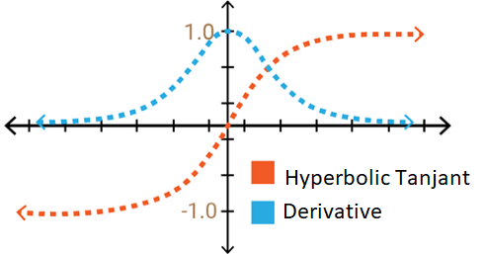
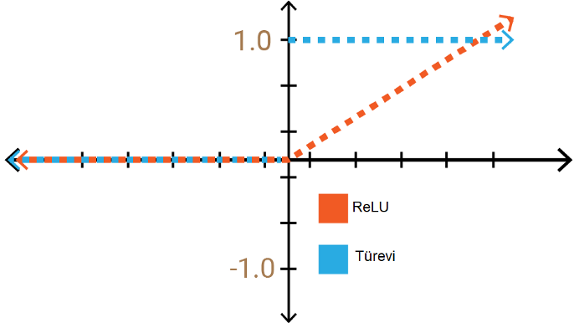

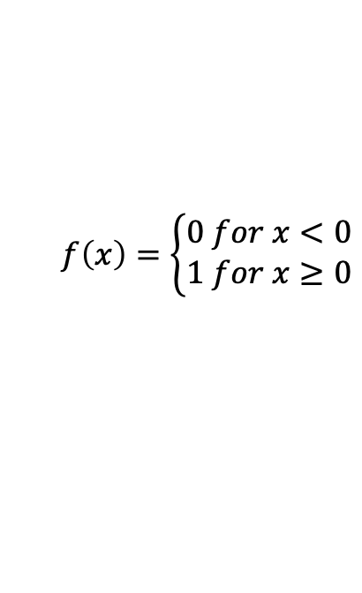
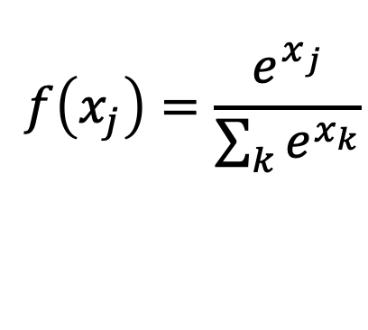
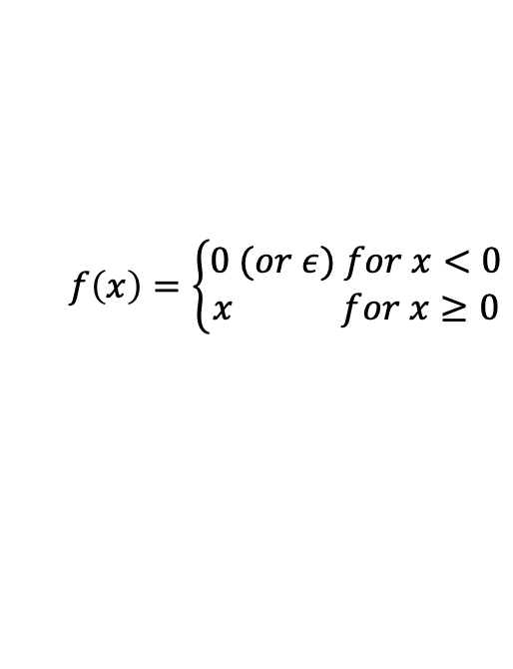

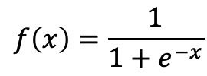
Activation Functions Summary
$$f\left(x\right)=\left\{\begin{matrix}0 for x<0 \\ 1 for x≥0\end{matrix}\right.$$
$$f\left(x\right)=\frac{1}{1+e^{−x}}$$
$$f\left(x\right)=x$$
$$f\left(x_{j}\right)=\frac{e^{x_{j}}}{\sum_{k}{e^{x_{k}}}}$$
Hyperbolic Tangent
Softmax Function
$$f\left(x\right)=\frac{e^{x}−e^{−x}}{e^{x}+e^{−x}}$$
$$f\left(x\right)=\left\{\begin{matrix}0 (or ε) for x<0 \\ x for x≥0\end{matrix}\right.$$

Slide 19
Learning Multi-layer Neural Network
Can we apply perceptron learning to each node, including hidden nodes?
Perceptron computes error e = y-f(w,x) and updates weights accordingly
Problem: how to determine the true value of y for hidden nodes?
Approximate error in hidden nodes by error in the output nodes
Problems:
  Not clear how adjustment in the hidden nodes affect overall error
  No guarantee of convergence to optimal solution

Slide 20
Gradient Descent for Multilayer NN
Quadratic function from which we can find a global minimum solution
y_{i}
Error function to minimize:
Weight update:
Activation function f must be differentiable
For sigmoid function:
Stochastic Gradient Descent (update the weight immediately)
y_{i}
Notes:
The SGD can be used to learn the weights of a multilayer ANN.

Slide 21
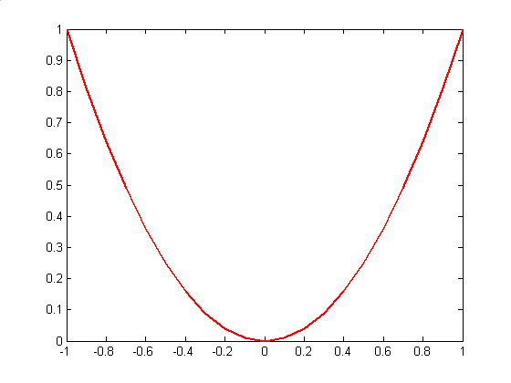
Gradient Descent for Multilayer NN
Weights are updated in the opposite direction of the gradient of the loss function.
Gradient direction is the direction of uphill of the error function.
By taking the negative we are going downhill.
Hopefully to a minimum of the error.
Gradient direction
w^{(k)}
w^{(k+1)}

Slide 22
Gradient Descent for Multilayer NN
For output neurons, weight update formula is the same as before (gradient descent for perceptron)
For hidden neurons:

Slide 23
Training Multilayer NN
Output
y
Hidden Layer
z₁
z₂
…
z_{D}
Input
x₁
x₂
x₃
…
x_{M}

Slide 24
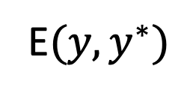
Training Multilayer NN
E
E$(y,y^{∗})$
Output
y
Hidden Layer
z₁
z₂
…
z_{D}
Input
x₁
x₂
x₃
…
x_{M}
How do we update these weights given the loss is available only at the output unit?
Notes:
For hidden nodes, the computation is not trivial because it is difficult to asses the error term without knowing what their output values should be.
Back-propagation solves this problem.

Slide 25
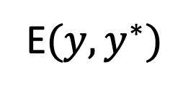
Error Backpropagation
Error is computed at the output and propagated back to the input by chain rule to compute the contribution of each weight (a.k.a. derivative) to the loss
E$(y,y^{∗})$
Output
y
z₁
z₂
…
z_{D}
A 2-step process
Forward pass - Compute the network output
Backward pass – Compute the loss function gradients and update
Hidden Layer
Input
x₁
x₂
x₃
…
x_{M}
https://mattmazur.com/2015/03/17/a-step-by-step-backpropagation-example/
Notes:
For hidden nodes, the computation is not trivial because it is difficult to asses the error term without knowing what their output values should be.
Back-propagation solves this problem.
The forward phase the weights obtained from previous iteration are used to compute the the output value for each neuron in the network.
The computation progresses in the forward direction: the output from layer k is used to compute outputs at level k+1.
During the backward phase the weight update formula is applied in the reverse direction: weights at level k+1 are updated before the weights at level k are updated.
This allows to use the error s for neurons at layer k+1 to estimate the errors for neurons at layer k.

Slide 26
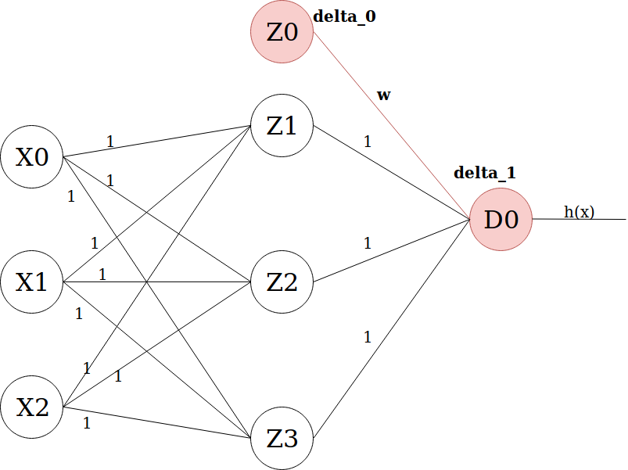
Backpropagation in other words
In order to get the loss of a node (e.g. Z0), we multiply the value of its corresponding f’(z) by the loss of the node it is connected to in the next layer (delta_1), by the weight of the link connecting both nodes.
We do the delta calculation step at every unit, back-propagating the loss into the neural net, and finding out what loss every node/unit is responsible for.

Slide 27
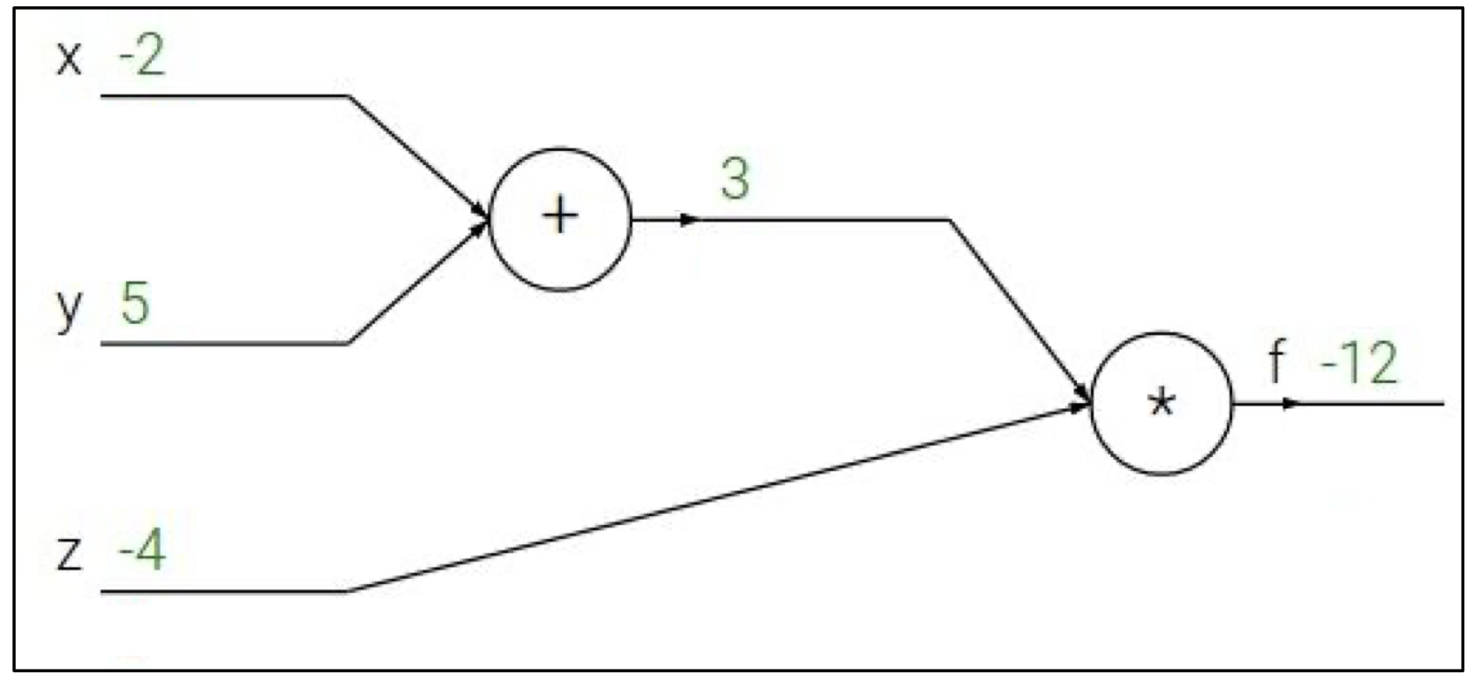
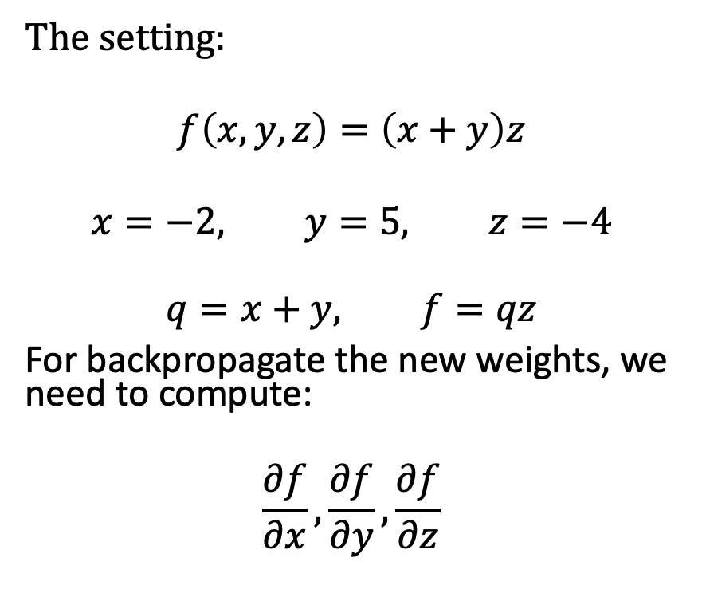
Backpropagation: a simple example
The setting:
$$f\left(x,y,z\right)=\left(x+y\right)z$$
$$x=−2, y=5, z=−4$$
$$q=x+y, f=qz$$
For backpropagate the new weights, we need to compute:
$$\frac{∂f}{∂x},\frac{∂f}{∂y},\frac{∂f}{∂z}$$

Slide 28
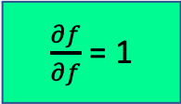
Backpropagation: a simple example
The setting:
$$f\left(x,y,z\right)=\left(x+y\right)z$$
$$x=−2, y=5, z=−4$$
$$q=x+y, f=qz$$
For backpropagate the new weights, we need to compute:
$$\frac{∂f}{∂x},\frac{∂f}{∂y},\frac{∂f}{∂z}$$
$\frac{∂f}{∂f}$ = 1

Slide 29
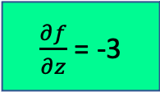
Backpropagation: a simple example
The setting:
$$f\left(x,y,z\right)=\left(x+y\right)z$$
$$x=−2, y=5, z=−4$$
$$q=x+y, f=qz$$
For backpropagate the new weights, we need to compute:
$$\frac{∂f}{∂x},\frac{∂f}{∂y},\frac{∂f}{∂z}$$
$\frac{∂f}{∂z}$ = -3

Slide 30
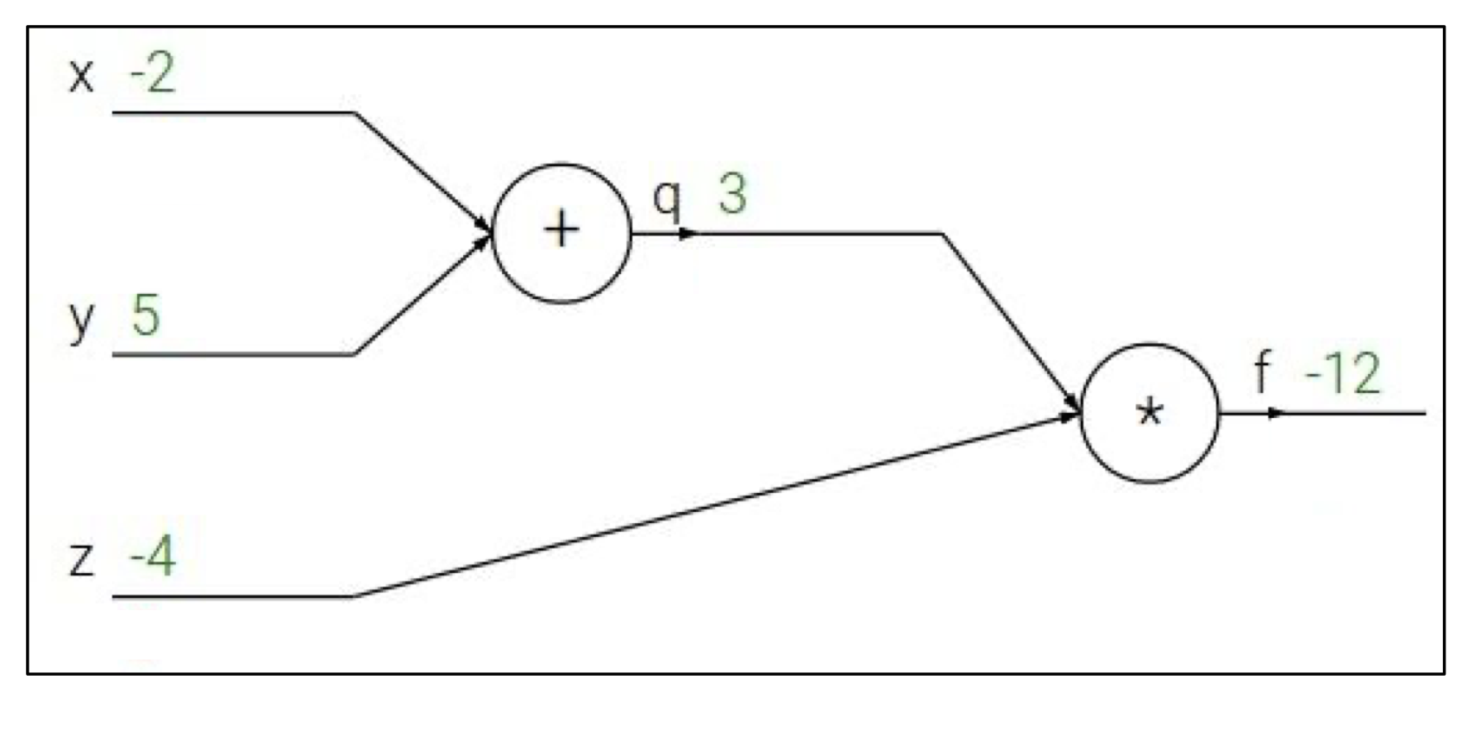
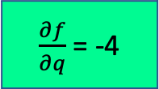
Backpropagation: a simple example
The setting:
$$f\left(x,y,z\right)=\left(x+y\right)z$$
$$x=−2, y=5, z=−4$$
$$q=x+y, f=qz$$
For backpropagate the new weights, we need to compute:
$$\frac{∂f}{∂x},\frac{∂f}{∂y},\frac{∂f}{∂z}$$
$\frac{∂f}{∂q}$ = -4

Slide 31
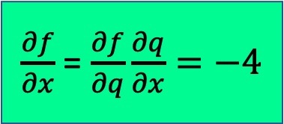
Backpropagation: a simple example
The setting:
$$f\left(x,y,z\right)=\left(x+y\right)z$$
$$x=−2, y=5, z=−4$$
$$q=x+y, f=qz$$
For backpropagate the new weights, we need to compute:
$$\frac{∂f}{∂x},\frac{∂f}{∂y},\frac{∂f}{∂z}$$
$\frac{∂f}{∂x}$ = $\frac{∂f}{∂q}\frac{∂q}{∂x}=−4$

Slide 32

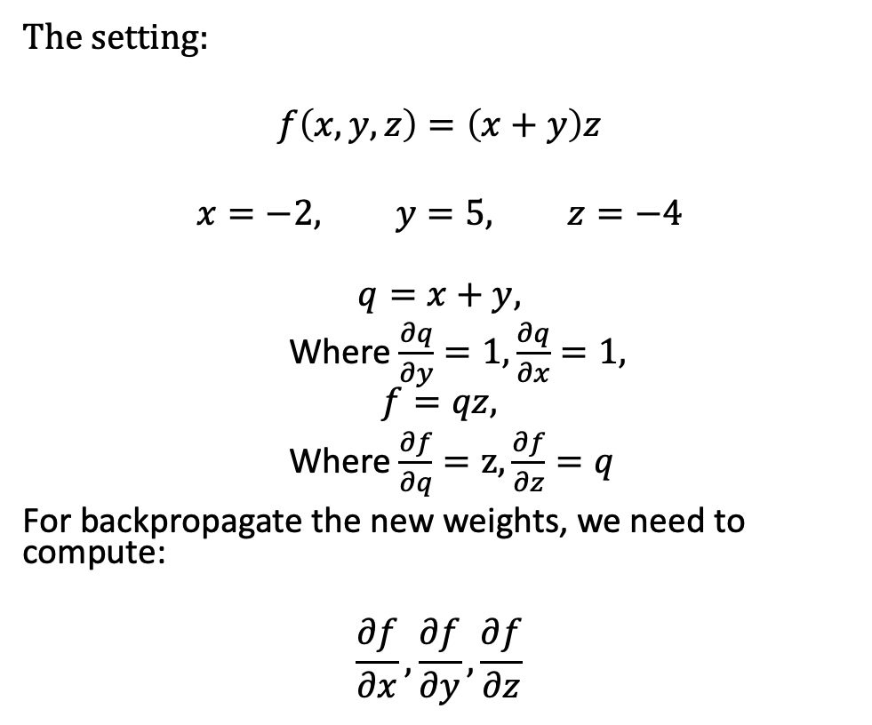
Backpropagation: a simple example
The setting:
$$f\left(x,y,z\right)=\left(x+y\right)z$$
$$x=−2, y=5, z=−4$$
$$q=x+y,$$
Where $\frac{∂q}{∂y}=1,\frac{∂q}{∂x}=1,$
$$f=qz,$$
Where $\frac{∂f}{∂q}=z,\frac{∂f}{∂z}=q$
For backpropagate the new weights, we need to compute:
$$\frac{∂f}{∂x},\frac{∂f}{∂y},\frac{∂f}{∂z}$$
$\frac{∂f}{∂y}$ = $\frac{∂f}{∂q}\frac{∂q}{∂y}=−4$

Slide 33
On the Key Importance of Error Functions
The error/loss/cost function reduces all the various good and bad aspects of a possibly complex system down to a single number, a scalar value, which allows candidate solutions to be compared.
It is important, therefore, that the function faithfully represent our design goals.
If we choose a poor error function and obtain unsatisfactory results, the fault is ours for badly specifying the goal of the search.

Slide 34
Design Issues in ANN
Number of nodes in input layer
  One input node per binary/continuous attribute
  k or log₂k nodes for each categorical attribute with k values
Number of nodes in output layer
  One output for binary class problem
  k or log₂k nodes for k-class problem
Number of nodes in hidden layer
Initial weights and biases

Slide 35
Characteristics of ANN
Multilayer ANN are universal approximators but could suffer from overfitting if the network is too large.
Gradient descent may converge to local minimum.
Model building can be very time consuming, but testing can be very fast.
Can handle redundant attributes because weights are automatically learnt.
Sensitive to noise in training data.
Difficult to handle missing attributes.

Slide 36

References
Artificial Neural Network. Chapter 5.4 and 5.5. Introduction to Data Mining.

